Slide 1

EDUCATION PATHWAYS
by TalentCorp

Slide 2

STUDENTS AFTERS SPM
Continue Tertiary Education?
Own Business?
Seek for a jobs?

Slide 3
EDUCATION PATHWAYS
Pre-University (Academic route)
University
Diploma
(Direct to industry pathway)
Career
TVET
(Skills-based route)
SPM
Skills Certifications

Slide 4

PRE-UNIVERSITY OPTION
Form 6 (STPM)
Foundation
Matriculation
A-Level

Slide 5

SIJIL PELAJARAN TINGGI MALAYSIA
(STPM)
Affordable (government schools) – Kolej Tingkatan 6
Recognised worldwide - STPM standard is recognised by Cambridge Assessment International Education, more than 2,000 universities globally.
Duration: 1 and half years
  Suitable for:
  Strong academic students - one of the most challenging pre-university programs in Malaysia.

Slide 6
FOUNDATION/ASASI
Offered by universities - Designed for entry into specific undergraduate degrees, particularly within the same university.
Usually linked to specific degree.
Duration: 1 year (2 semester)
  Suitable for:
  Students with clear career path – students who know what they want to study, desire a fast-track.

Slide 7
MATRICULATION
Malaysian Matriculation Programme (Program Matrikulasi KPM) is program by the Ministry of Education (MOE)
Transitioning to Kementerian Pengajian Tinggi (KPT) in 2027
Widely recognized by local universities for undergraduate studies and select foreign universities.
Duration: 1 to 2 years
  Suitable for:
  Students desire a fast – track , lower cost to enroll and students who prefer public universities.

Slide 8
A-LEVEL
Based on the UK system, equivalent to STPM.
100% exam-based, typically covering 3-4 subjects.
Recognized globally and locally for degree entry, managed by Cambridge (CAIE) or Edexcel
15–24 months
  Suitable for:
  Students who wants to study abroad.
  Prepares students well for intense, research-driven degree programs.

Slide 9
DIPLOMA
Direct to industry pathway
Practical focused – More hands-on than general academic routes
Direct employment or entry into bachelor's degree (possible to credit transfer).
24 to 36 month
  Suitable for:
  Designed for specific industry roles, making graduates highly employable.

Slide 10
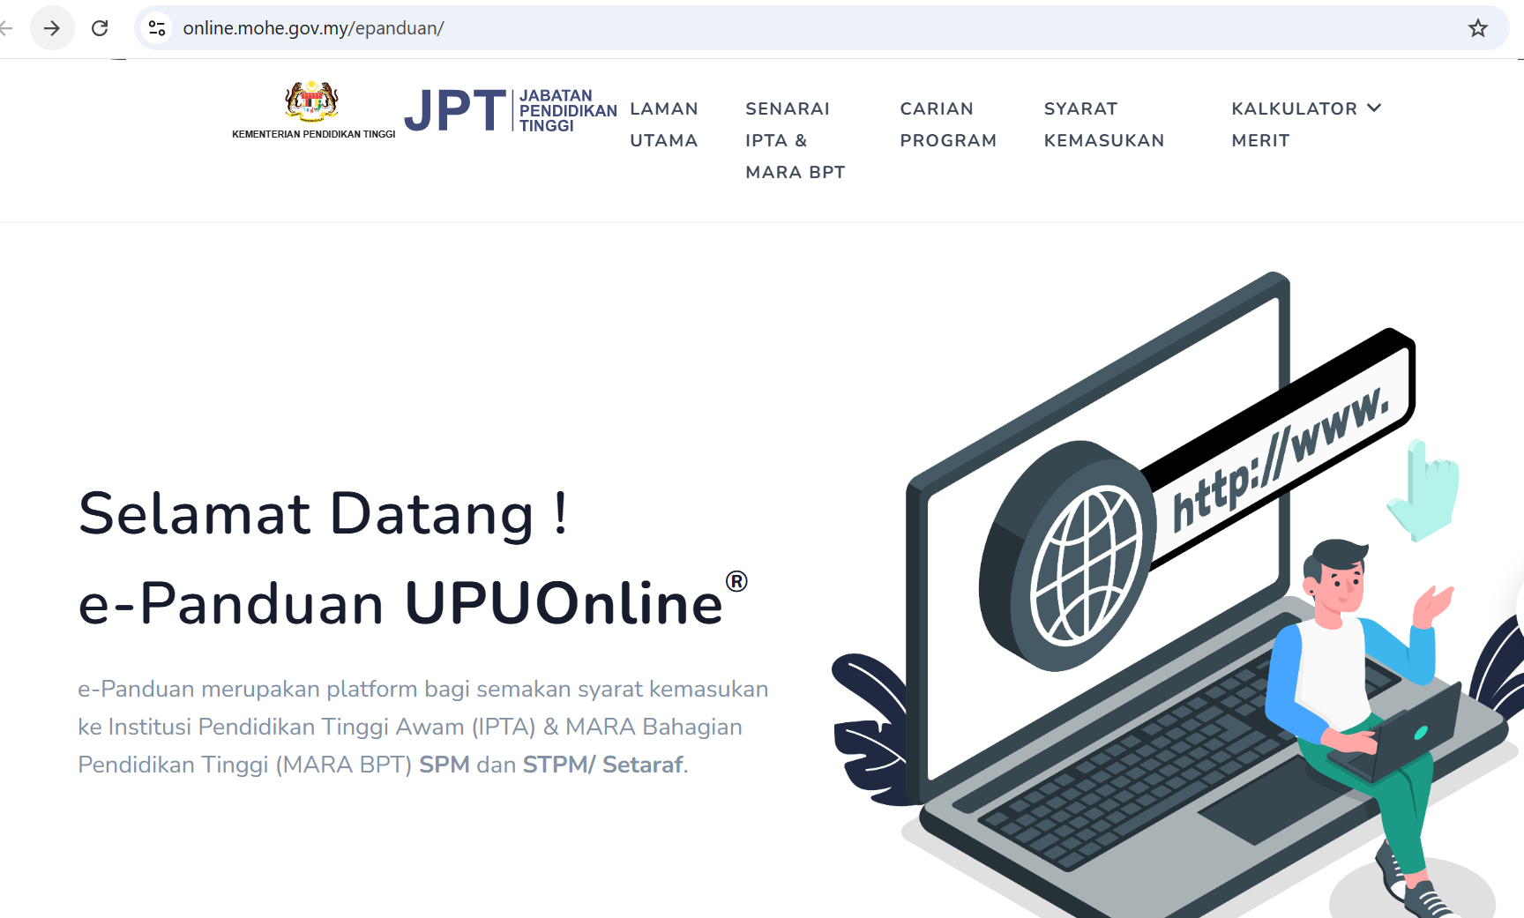
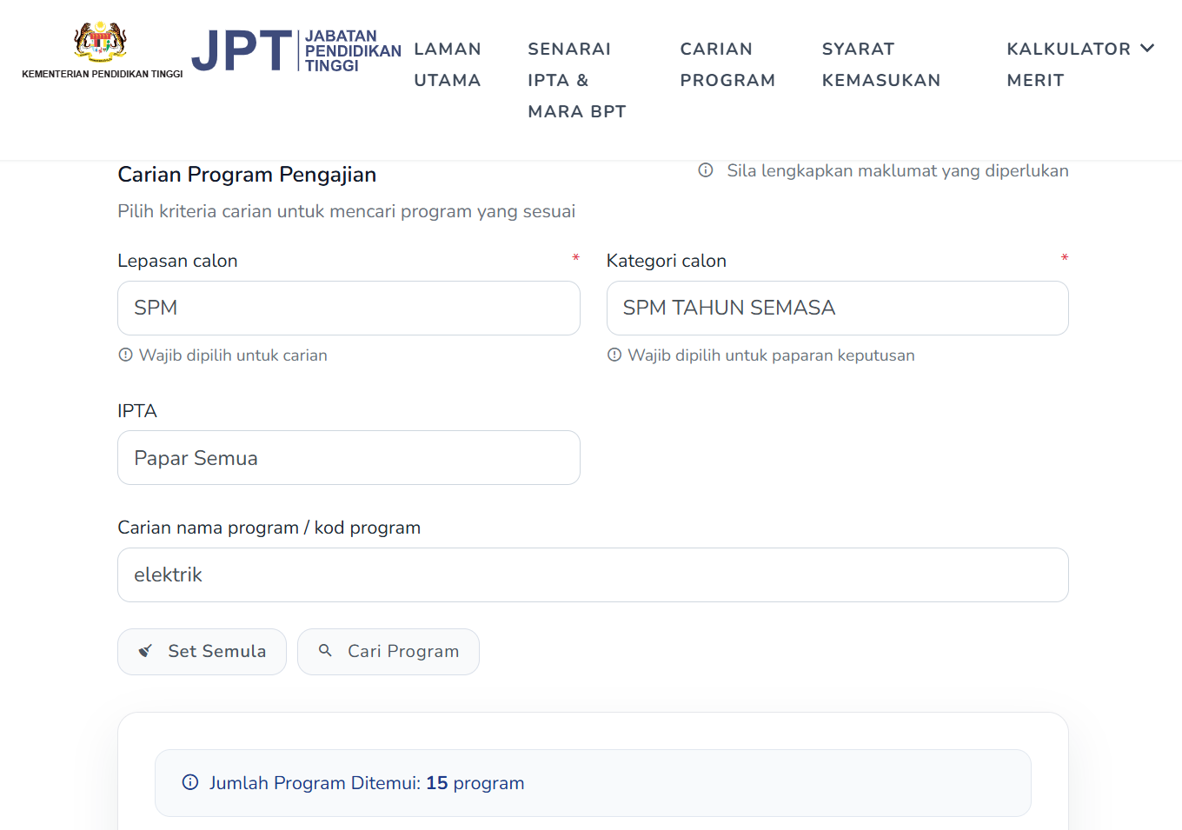
GET INFORMATION THROUGH UPUONLINE
List IPT
Search for programmes
Admission requirements
Merit Calculator
https://online.mohe.gov.my/epanduan/

Slide 11
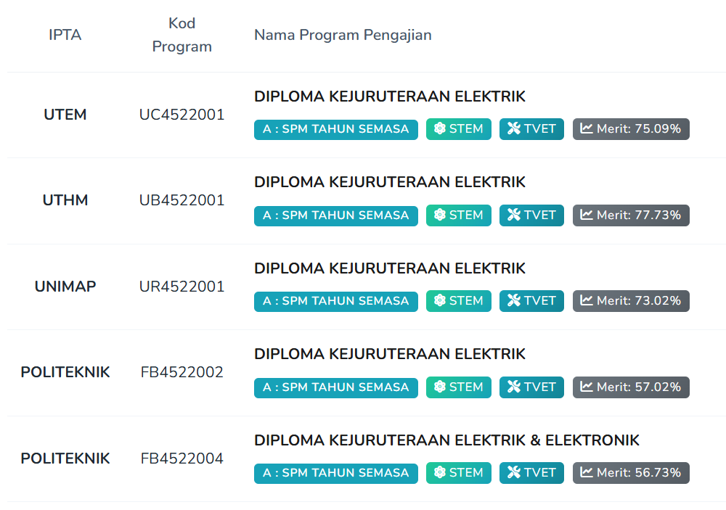
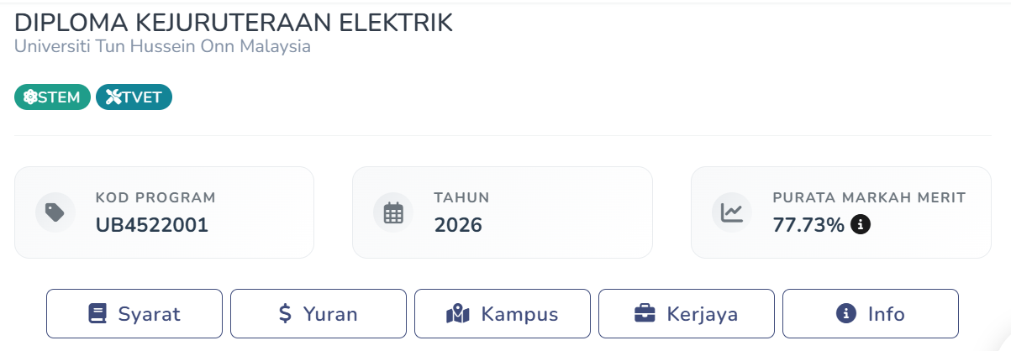
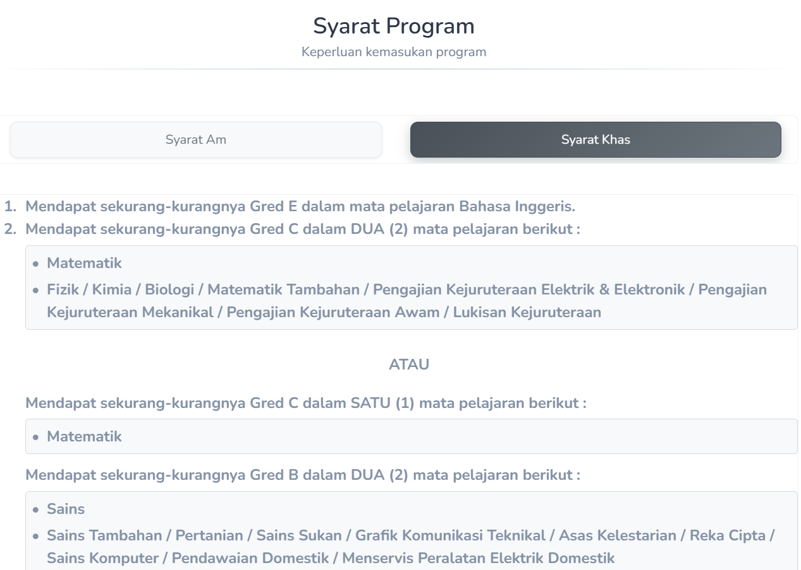
GET INFORMATION THROUGH UPUONLINE
Take note on the merit %
https://online.mohe.gov.my/epanduan/

Slide 12

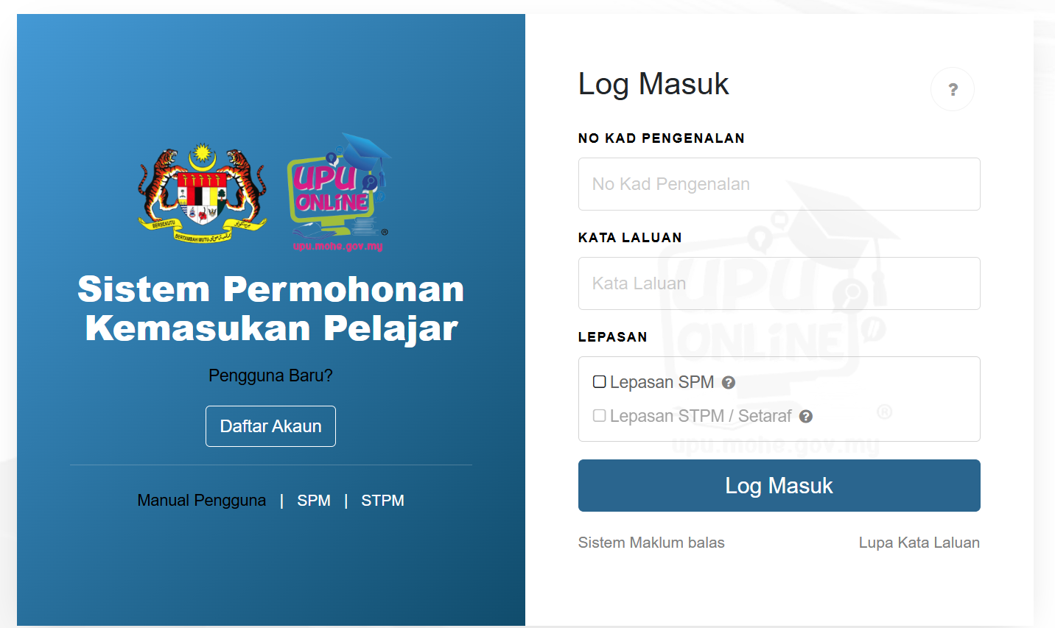
APPLICATION THROUGH UPUONLINE
Choose suitable program based on:
SPM result
Merit %
Interest and personality
Current Market
*Register through: https://online.mohe.gov.my/UPUOnlinev2/login

Slide 13




UNIVERSITY
Public University
Private University
Research University
Company Linked University
Comprehensive University
* Government Linked University
Focused University
Malaysian Technical University Network (MTUN)
Please ensure that the university or programme is registered with the Malaysian Qualifications Agency (MQA) to confirm that it is recognized by the Malaysian Government
Link: https://www.mqa.gov.my/
Notes:
Sunway, Taylor, dhu, albukhary.

Slide 14
TVET
Technical & Vocational Education and Training
Practical, industry – focused skills training to produce highly skilled, employable workers under the National TVET Policy 2030
Example institution: Polytechnic, Kolej Vokasional, ILKA / GiatMARA, MARA Higher Skills College (KKTM), MARA Japan Industrial Institute (MJII)
High job demand and faster employment
  Suitable for:
  Students who prefer hands-on training, skills application, and competency-based learning rather than theoretical academic studies.

Slide 15
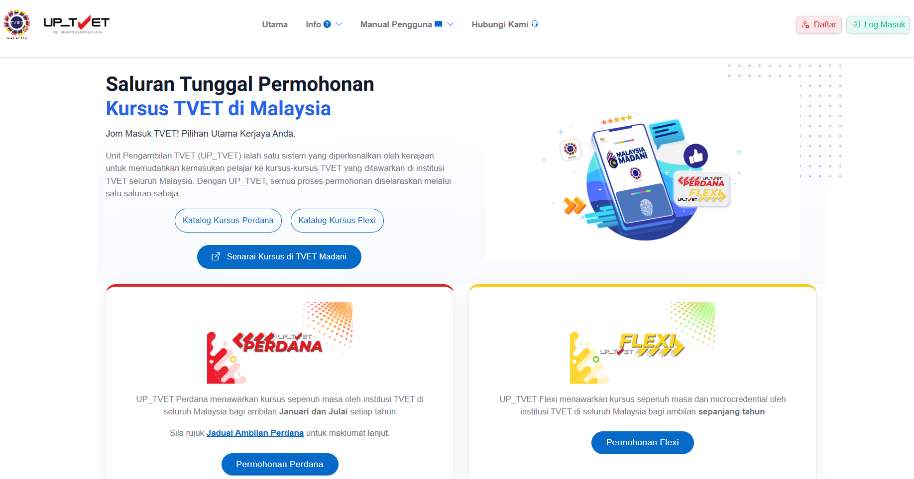

APPLICATION THROUGH UPTVET
Choose suitable program based on:
Skill
Interest and personality
Current Market
*Register through: https://mohon.tvet.gov.my/

Slide 16
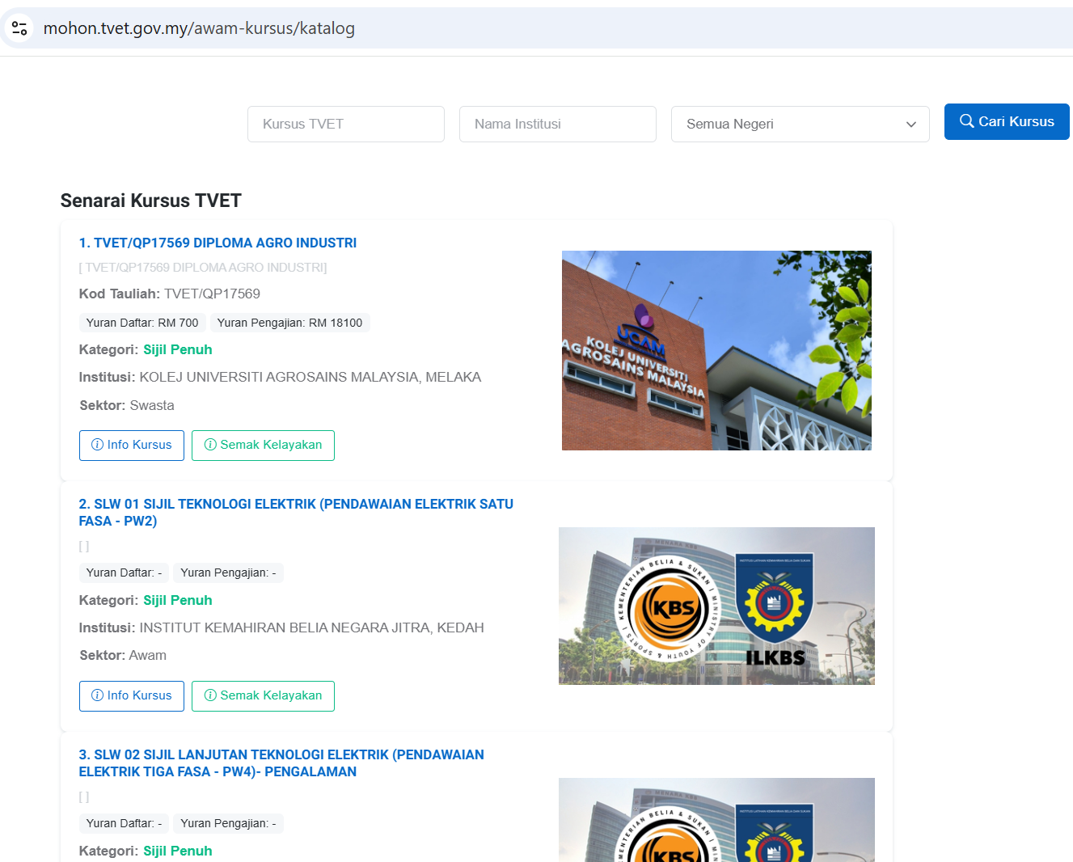
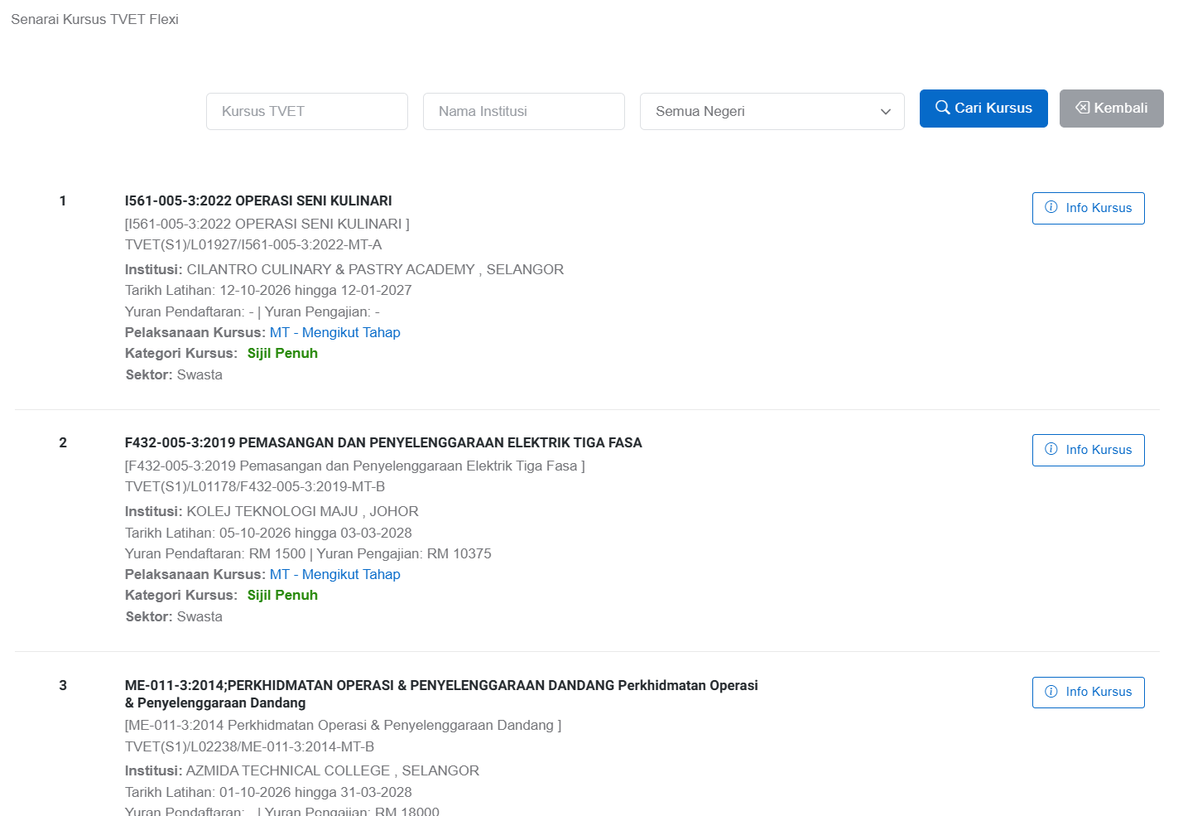
TVET PERDANA or TVET FLEXI
TVET Flexi
TVET Flexi
Full-time courses offered by TVET institutions across Malaysia with intakes in January and July each year.
Full-time courses and micro credentials offered by TVET institutions across Malaysia with year-round intake.

Slide 17
SKILLS CERTIFICATIONS
Credential confirming specialized skills, knowledge, and competency in a specific field
Offered by universities, professional associations, or companies.
Focus on practical training and industry standards rather than academic degrees.
Eg: Malaysia Skills Certification (SKM), Courses through HRDCorp and MyMahir

Slide 18
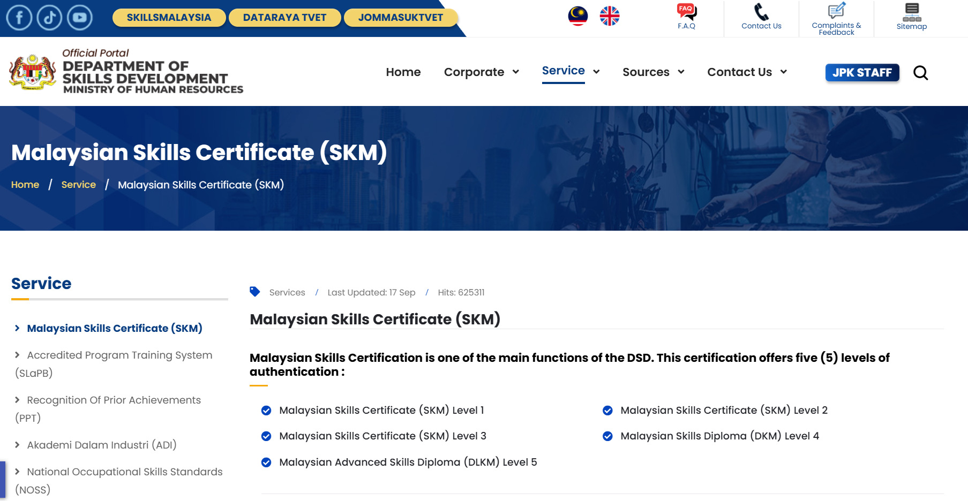
MALAYSIA SKILLS CERTIFICATION
(SKM)
Malaysian Skills Certification (SKM) offers five (5) levels of authentication :
Malaysian Skills Certificate (SKM) Level 1
Malaysian Skills Certificate (SKM) Level 2
Malaysian Skills Certificate (SKM) Level 3
Malaysian Skills Diploma (DKM) Level 4
Malaysian Advanced Skills Diploma (DLKM) Level 5
This certification may be obtained through by three (3) methods :
Accredited Programme Training System (SLaPB)
Akademi Dalam Industri (ADI)
Recognition Of Prior Achievements (PPT)
Manage by Jabatan Pembangunan Kemahiran (JPK), Ministry of Human Resources (KESUMA)

Slide 19
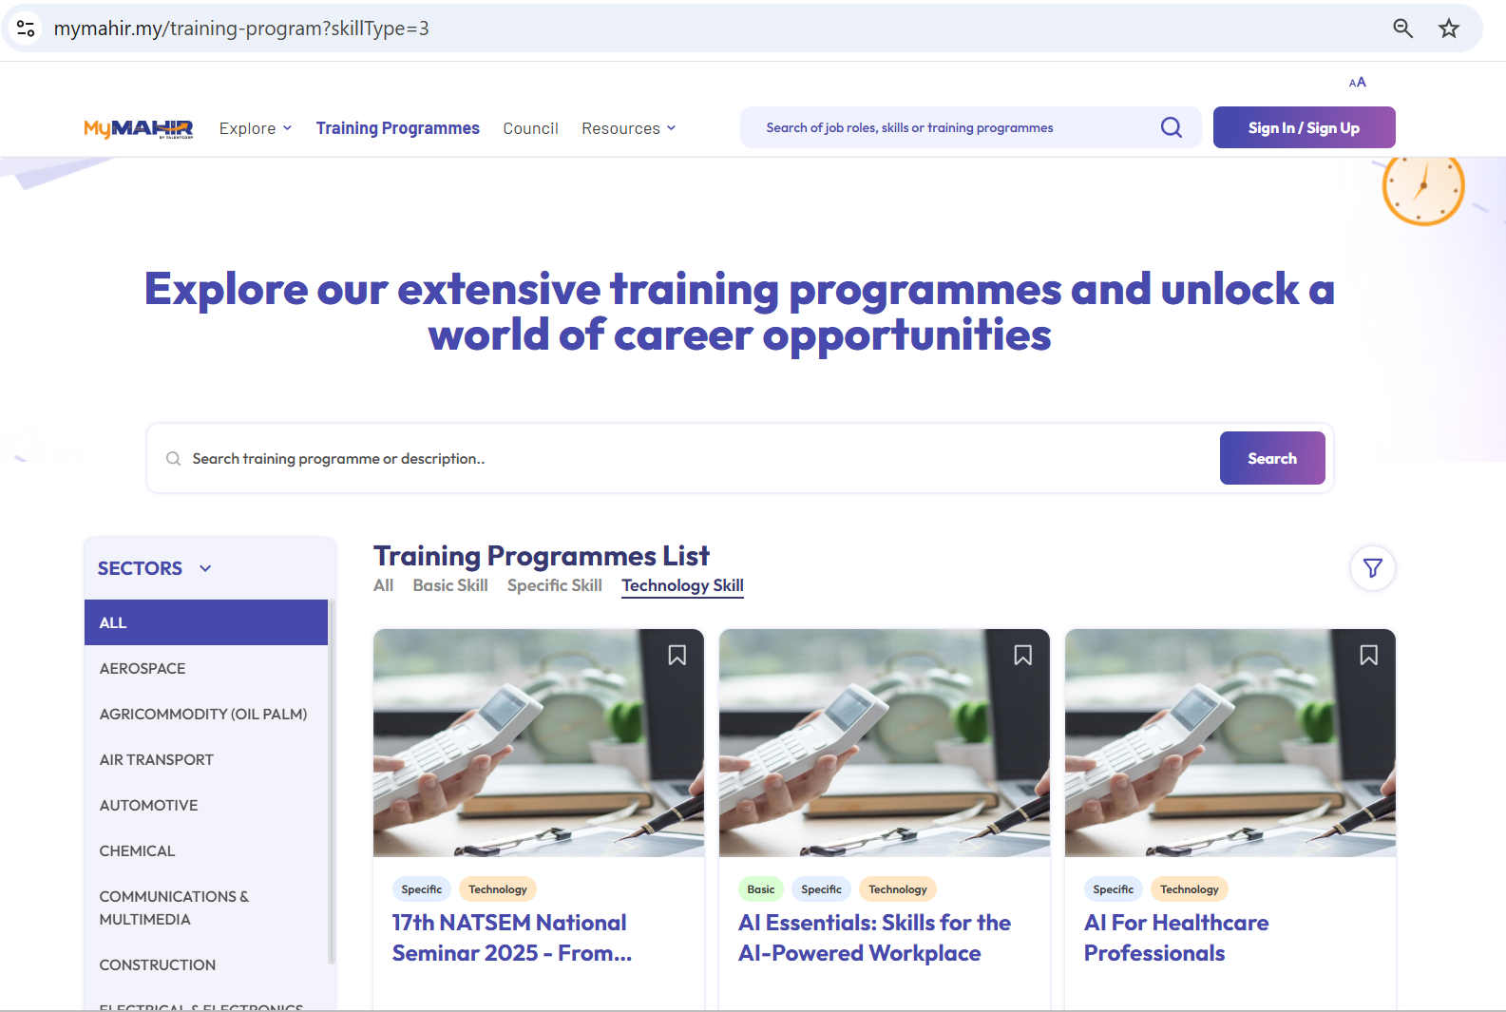
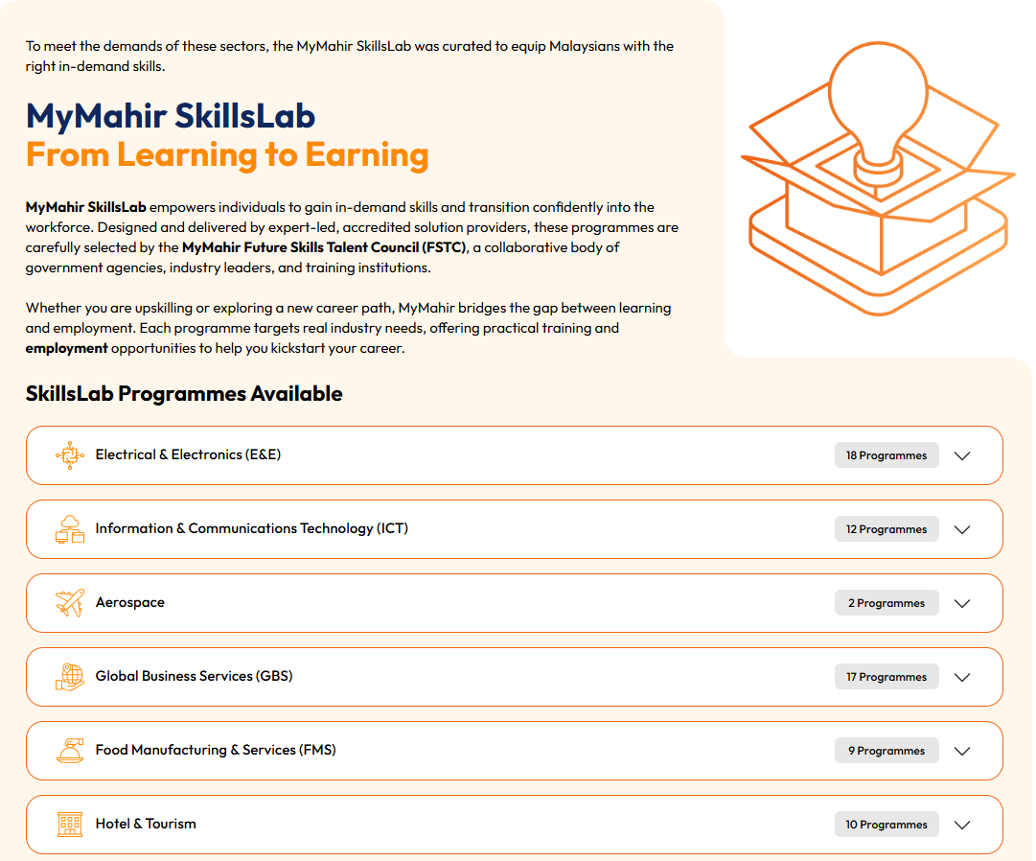
MyMahir List of Training
Training list based on sectors listed in MyMahir AI Impact Study
Search potential training course through MyMahir platform.
https://www.mymahir.my/training-program
Program offered by MyMahir Future Skills Talent Council (FSTC) to empowers individuals to gain in-demand skills and transition confidently into the workforce.
https://www.mymahir.my/council

Slide 20
SCHOLARSHIPS & FINANCIAL AID
Government Scholarships | Corporate Scholarships
Jabatan Perkhidmatan Awam (JPA) | PETRONAS Education Sponsorship Programme (PESP)
Majlis Amanah Rakyat (MARA) | Yayasan Khazanah Scholarship
Bank Negara Malaysia – Kijang Scholarship | Yayasan Sime Darby Scholarship
 | Yayasan UEM Scholarship
 | Shell Malaysia Scholarship
 | Yayasan Tenaga Nasional Scholarship

Slide 21
BONDED VS NON-BONDED SCHOLARSHIPS
A BONDED SCHOLARSHIP
A NON-BONDED SCHOLARSHIP
A bonded scholarship requires students to work for the sponsor after graduation for a certain number of years.
Bond duration: usually within 3 years up to10 years – depending on contract.
Breaking the bond will incur a penalty (repay full cost + extra fees)
Eg: Bank Negara Malaysia Kijang Scholarship, Tenaga Nasional Berhad Scholarship
A non-bonded scholarship does NOT require you to work for the sponsor after graduation.
No contract to serve employer
Freedom to choose any career
Highly competitive
No guaranteed job after graduation
Some may only partially cover costs
Eg: Kuok Foundation Scholarship , YTL Foundation Scholarship

Slide 22
STUDY LOANS
Perbadanan Tabung Pendidikan Tinggi Nasional (PTPTN)
Bank education loans – eg Maybank, CIMB, Hong Leong Bank
Pay later after graduation.
Some student loans can be converted into scholarships if students meet the requirements.

Slide 24







FROM SCHOOL TO CAREER
Your future depends on what you do TODAY!
School
Application process to pursue in STEM/TVET field (UPUOnline/ UPTVET)
Graduate
Securing employment in the STEM/TVET field
Achieving a stable career.
Choosing STEM package
IMPORTANT!!
Notes:
You may be nervous thinking that this is the most important decision of your life
Even though that this is important, but we are here to help!
We would like to share on a yearly publication of Critical Occupations List
6

