Slide 1

TALENT CORPORATION MALAYSIA BERHAD
Driving Malaysia’s Talent Strategy
MyMahir Skills Trends and Jobs
MyNext Learning Management System (LMS)

Slide 2




YES!
Rock The School
ICE
BREAKING
START
Notes:
Ask participant what course they studying? Do they know what are the jobs and skills in demand nowadays? Ask them to tell and share.

Slide 3

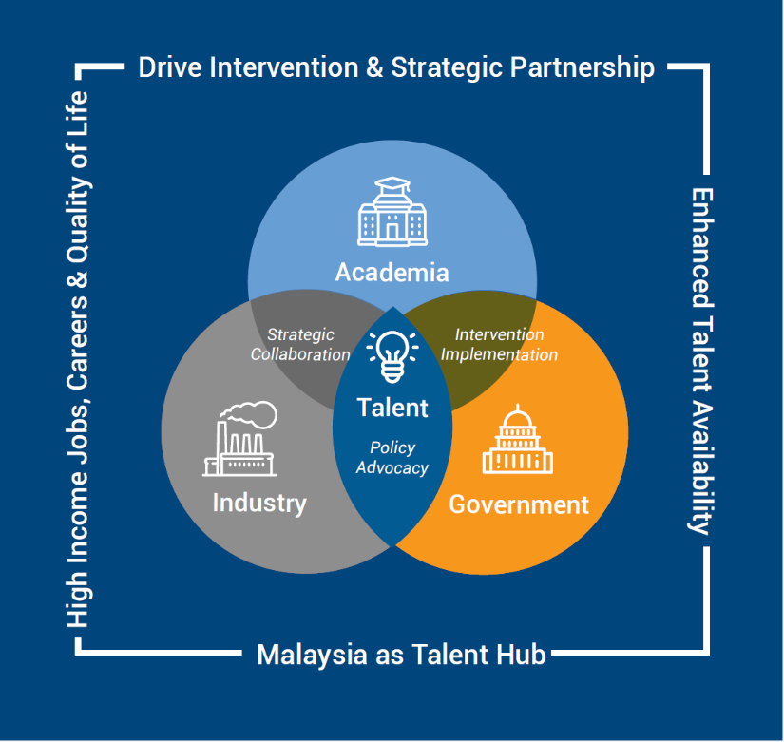

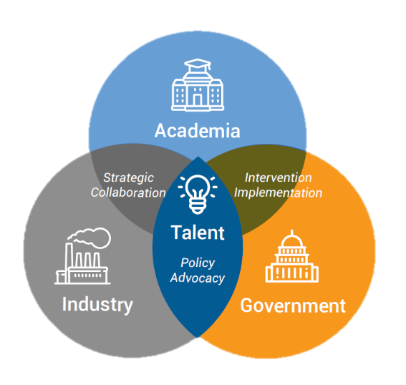






ABOUT
TALENTCORP
OUR TALENT-FOCUSED STRATEGY:
Agency under the
Ministry of Human Resources (MoHR)
Announced in 10th Malaysia Plan.
Began operations on
1st January 2011
To transform Malaysia into a
Global Talent Hub
Attract, nurture, and retain
the right expertise
to spur economic growth
to achieve high-income nation
Advocate
POLICIES
Drive strong & effective
PARTNERSHIPS
How?
Introduce
BEST PRACTICES
Intervention
PROGRAMMES

Slide 4















TALENTCORP’S NATIONAL INITIATIVES
TALENTCORP’S ENGINES: DATA & INDUSTRY-DRIVEN
An integrated talent solution and analytics platform
Insights and intelligence on industry talent demand and sought-after occupations
A one-stop platform for Malaysian diaspora to connect, collaborate and co-create
Knowledge base and insights on industry expatriate needs
A national skills intelligence platform that provides data-driven insights on roles and skills demand
PARTNERSHIPS: MINISTRY | AGENCIES | INDUSTRY | ACADEMIA | TALENT
SCHOOL
UNIVERSITY
PROFESSIONALS
WOMEN
DIASPORA
VETERANS
IMPACT STUDY
1:3 Internship Policy

Slide 5

Unveil MyMahir Today
What Is
MyMahir
The MyMahir.my platform serves as the main national reference in career planning and training – not only for students, employees and employers, but also for policymakers and training providers to strengthen the coordination of national talent development.
MyMahir Malaysia Critical Occupations List (MyCOL)
2. MyMahir Impact Study

Slide 6

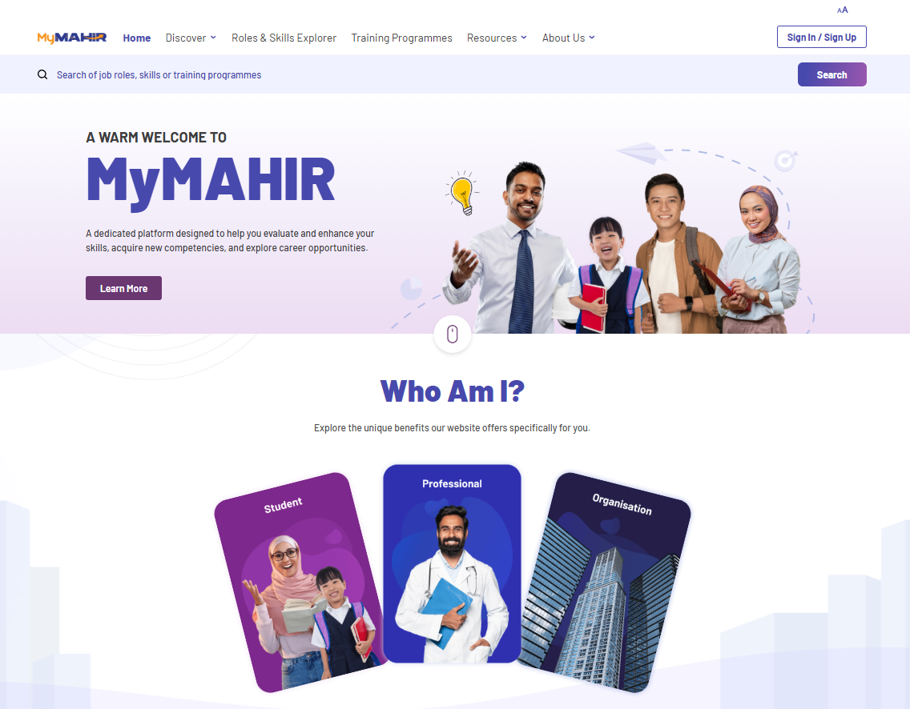
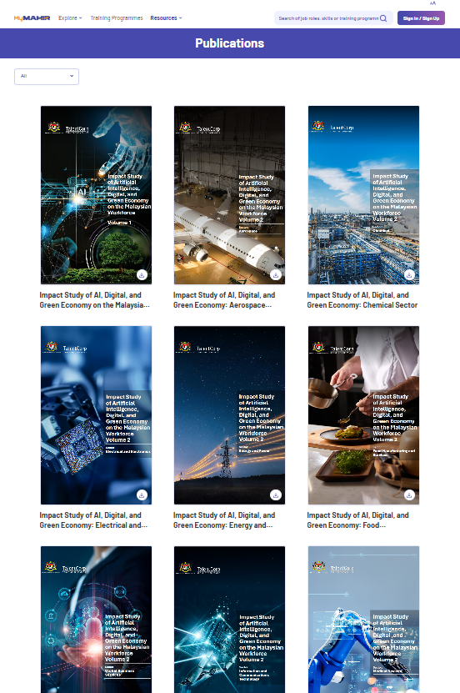
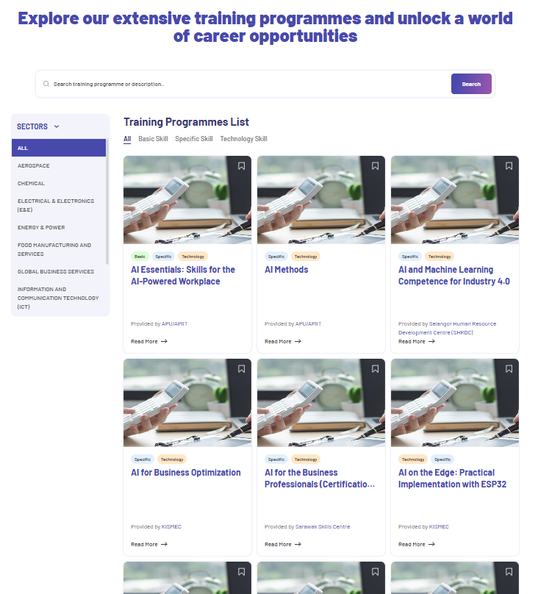
ONLINE PLATFORM
www.mymahir.my
ANIMATED SLIDE
Designed to help users evaluate and enhance
their skills, acquire new competencies, explore career opportunities, and plan their future based on the real needs of the
industry

Slide 7
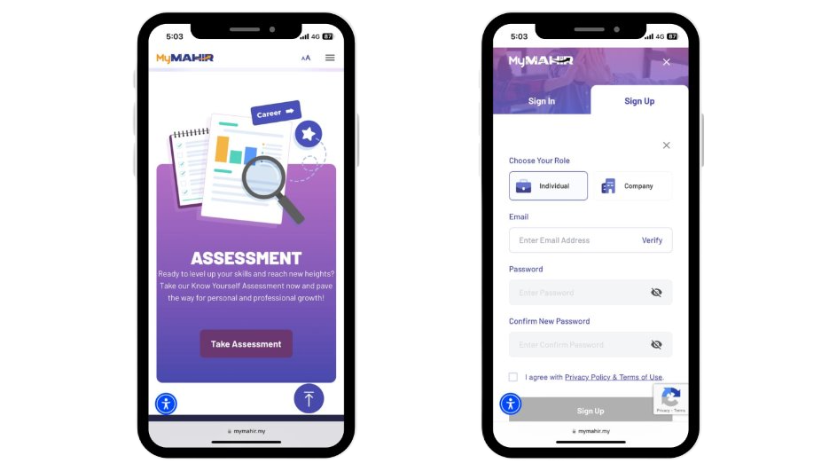


mymahir.my

Slide 8

mymahir.my

Slide 9
Want to know more about MyCOL
MyMAHIR CRITICAL OCCUPATION LIST 2024/2025

Slide 10

















MyCOL Background
As part of efforts under the 11th Malaysia Plan to address skills mismatches in the labour market, the Critical Skills Monitoring Committee (CSC) was established, jointly led by TalentCorp and the Institute of Labour Market Information and Analysis (ILMIA). One of the CSC’s key initiatives is to construct a COL that identifies occupations that are sought after and hard-to-fill in Malaysia’s economy.
We Worked Together With:
128
Industry Bodies/Associations
~5,078
Companies in 18 Sectors
31
Government Ministries/Agencies engaged
Facts & Figures
2015
Pilot COL 2015/2016
MyCOL 2024/2025
The eight edition
ReGIONAL COVERAGE
Deep Dive into regional talent mismatches
66
Critical Occupations comprising of High-Skilled, Semi-Skilled, and TVET Occupations
Consulted and Obtained Valuable Inputs from:
MOHR, KE, MITI, MIDA, MOHE, DOSM
Human Capital Policy Interventions
MOHE
University Course Review
JPA/MARA
Scholarship management
TVET Talent
Multiple Agencies
Employers
Recruitment and training strategy
Returning Expert Programme
Resident Pass Talent
Source: Critical Skills Monitoring Committee

Slide 11


MyCOL Over The Years
10 years
Annual publication
Since MyCOL Inception (2015)
Updated information on occupational shortage
48 critical occupations
59 critical occupations
42 critical
occupations
37 critical
occupations
Review and Enhancement 2.0
2016/2017
2018/2019
2020/2021
2022/2023
2015/2016
2017/2018
2019/2020
2022
Review and Enhancement 1.0
2024/2025
42 critical
occupations
58 critical
occupations
58 critical occupations
66 critical occupations
Notes:
MyCOL identifies occupations with significant labour market shortages that may constrain economic growth if unaddressed, based on rigorous evidence and stakeholder inputs [1]
Applied across critical government programmes including MOHE academic programme review, MOHR jobs demand identification, and TalentCorp's Returning Expert Programme and Residence Pass-Talent initiatives [1]
Widely referenced by OECD, Khazanah Research Institute, industry players, training providers, and career platforms as credible national labour market intelligence tool [1]

Slide 12



Critical Occupation Criteria
01
02
03
Skilled
Sought-after
Strategic
Job groups 1-8 (high, semi-skilled) excluding Elementary Occupations (MASCO 9) - low/ unskilled
Occupation demand exceeds the supply of workers, despite the best efforts of employers to hire
Essential to Malaysia’s economic development goals are closely linked to Malaysia’s economic growth

Slide 13
MyCOL 2024/ 2025 List - 66 Occupations
MASCO | Description
1121 | Managing Directors and Chief Executives
1211 | Finance Managers
1212 | Human Resource Managers
1213 | Policy and Planning Managers
1214 | Business Service Managers
1216 | Quality Managers
1221 | Sales and Marketing Managers
1311 | Agricultural, Forestry and Livestock Production Managers
1321 | Manufacturing Managers
1324 | Supply, Distribution and Related Managers
1511 | Information and Communications Technology Managers
2113 | Chemists
2121 | Mathematicians, Actuaries and Statisticians
2141 | Industrial and Production Engineers
2142 | Civil Engineers
2144 | Mechanical Engineers
2145 | Chemical Engineers
2146 | Mining Engineers, Metallurgists and Related Professionals
2149 | Engineering Professionals (Excluding Electrotechnology) Not Elsewhere Classified
2151 | Electrical Engineers
2152 | Electronic Engineers
2166 | Graphic and Multimedia Designers
MASCO | Description
2171 | Managing Directors and Chief Executives
2182 | Manufacturing Professionals
2212 | Specialist Medical Practitioners
2221 | Nursing Professionals
2262 | Pharmacists
2263 | Environmental and Occupational Health and Hygiene Professionals
2264 | Physiotherapists
2311 | University and Higher Education Teaching Professionals
2411 | Accountants and Auditors
2412 | Financial and Investment Advisers
2413 | Financial Analyst
2426 | Research and Development Professionals
2431 | Advertising and Marketing Professionals
2511 | Computer System Analysts
2512 | Software Developers
2514 | Application Programmers
2519 | Software and Application Developers and Analysts Not Elsewhere Classified
2521 | Database Designers and Administrators
2522 | Information Technology System Administrators
2523 | Computer Network Professionals
2524 | Data Professionals
MASCO | Description
2531 | Cyber Security Professionals
2541 | Animation and Visual Effects Professionals
2542 | Digital Games and E-Sport Professionals
2543 | Creative Contents Designer Professionals
3111 | Chemical and Physical Science Technicians
3112 | Civil Engineering Technicians
3113 | Electrical Engineering Technicians
3114 | Electronics Engineering Technicians
3115 | Mechanical Engineering Technicians
3118 | Draughtspersons and Surveying Technicians
3119 | Industrial and Production Technicians
3122 | Manufacturing Supervisors
3151 | Aircraft Technicians
7212 | Welders and Flame Cutters
7231 | Motor Vehicle Mechanics and Repairers
7233 | Agricultural and Industrial Machinery Mechanics and Repairers
7412 | Electrical Mechanics and Fitters
8141 | Rubber Products Machine Operators
8182 | Steam Engine and Boiler Operators
8189 | Stationary Plant and Machine Operators Not Elsewhere Classified
8332 | Heavy Truck and Lorry Drivers
8341 | Mobile Farm and Forestry Plant Operators
8343 | Crane, Hoist and Related Plant Operators

Slide 14
Overview of Critical Occupations
09 Persistent Occupations
05 New Occupations
MASCO 2020
Description
MASCO 2020
Description
1211
Finance Managers
2262
Pharmacist
1214
Business Services Managers
2264
Physiotherapist
1511
Information and Communications Technology Managers
3111
Chemical and Physical Science Technicians
2141
Industrial and Production Engineers
3118
Draughtspersons and Surveying Technicians
2144
Mechanical Engineers
7231
Motor Vehicle Mechanics and Repairers
2182
Manufacturing Professionals
2512
Software Developers
2522
Information Technology System Administrators
3115
Mechanical Engineering Technicians

Slide 15
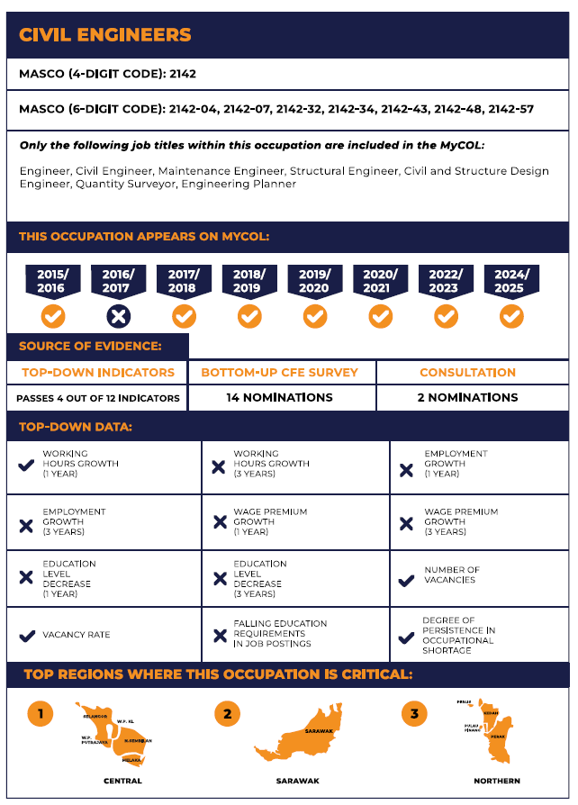
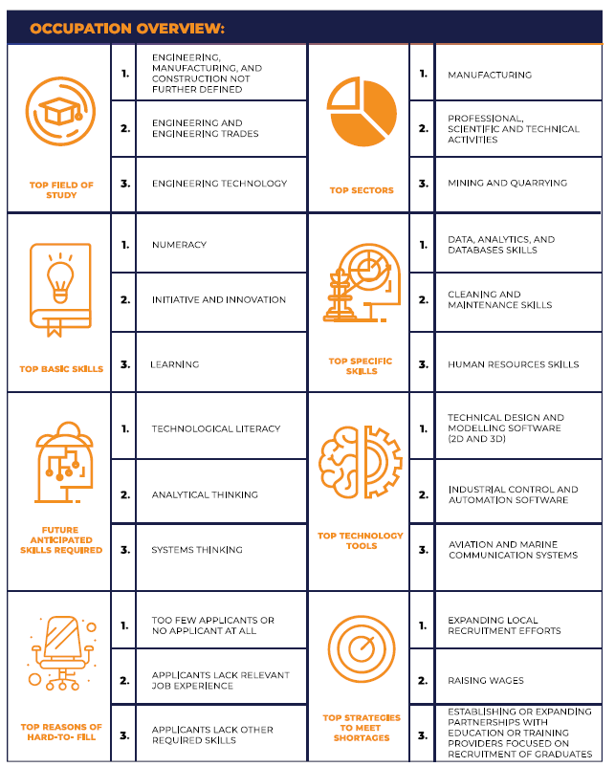
MyCOL IN MALAYSIA

Slide 16
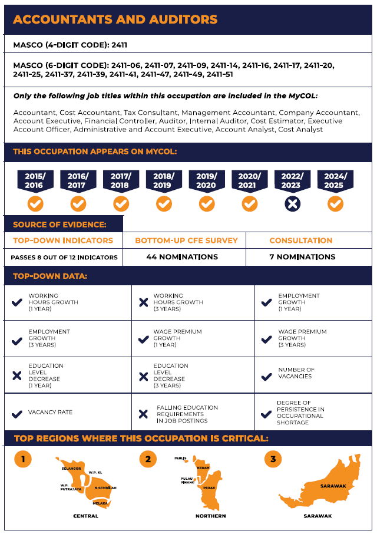
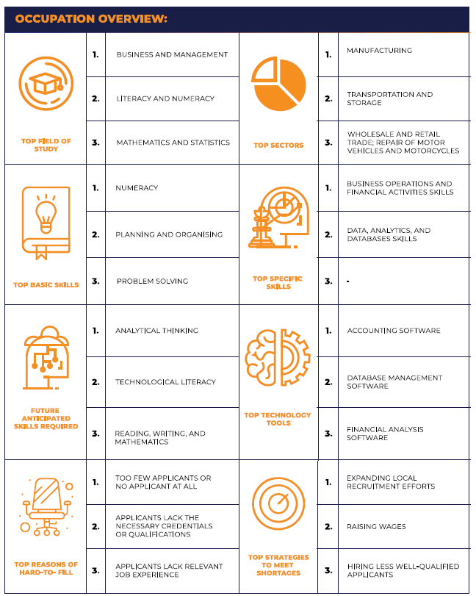
MyCOL IN MALAYSIA

Slide 17
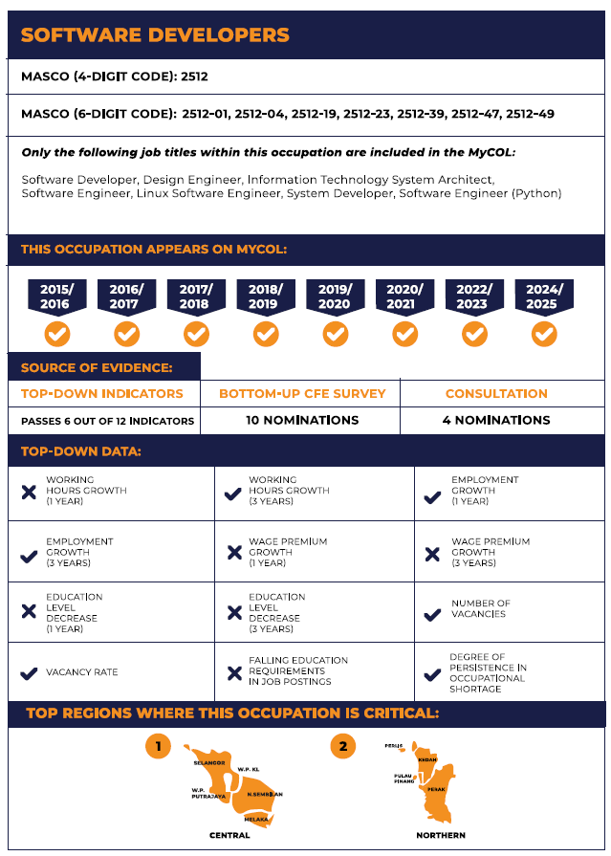
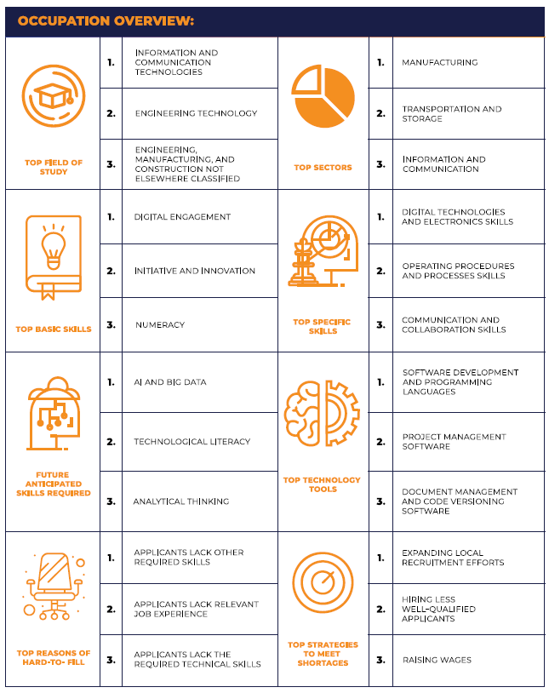
MyCOL IN MALAYSIA

Slide 18
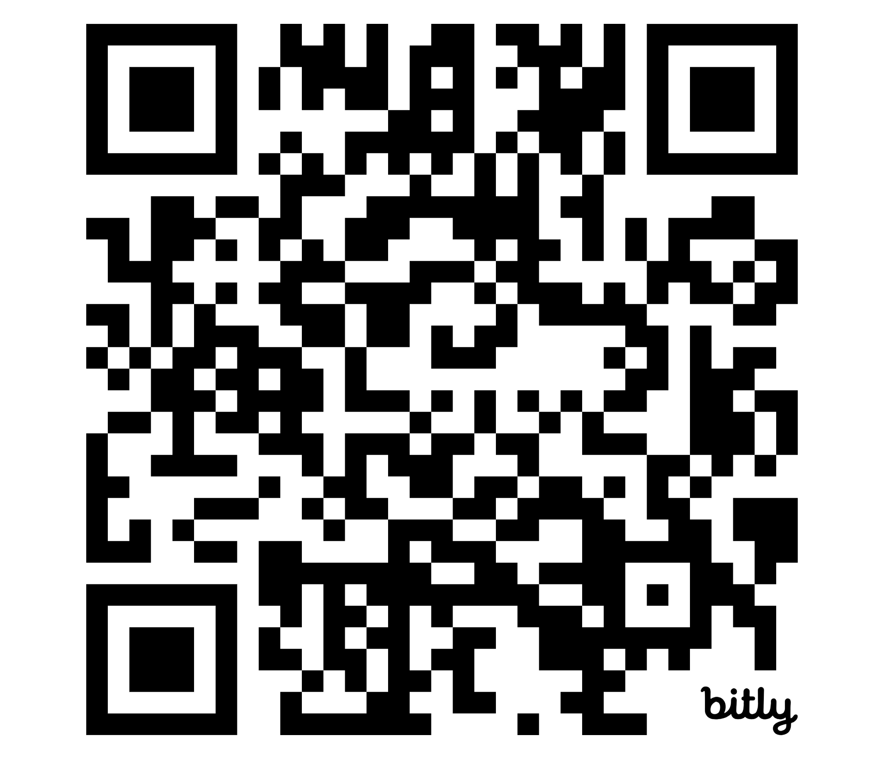
QR TO MYCOL
Prompt the report into an AI tool and identify the answers to the following:
List of high demand jobs.
Skills needed in the future
Key takeaways from the report.
Share your answer.
QR Code to MyMahir Malaysia Critical Occupations List (MyCOL)

Slide 19
Next, what is MyMahir Impact Study

Slide 20
Following announcement by the Minister of Human Resource, TalentCorp was tasked to deliver an impact study of AI, Digital and Green Economy to Future Proof Malaysian Workforce
Impact Study of Artificial Intelligence (AI), Digital and Green Economy on Malaysian Workforce
Study on the effect of 3 key trends shaping global landscape towards Malaysian workforce and work landscape:
Artificial Intelligence
Digital
Green Economy
Study to be conducted across 3 phases:
Reference for policymakers and industry to prepare the workforce of the future
Phase 1
Phase 2
Phase 3
10 sectors
Completed September 2024
12 sectors
Completed December 2025
To be
confirmed

Slide 21























Objective
Understand the impact of AI, Digital and Green Economy on the Malaysian workforce, and identify the skills, training programmes and pivoting strategies required to address the impact
Key Deliverables
Phase 1
Phase 2
1
Impact Study Report containing:
Impact of AI, Digital and Green Economy to industries, roles and skills
Pivoting strategies for impacted roles
Mapping of training programmes to skills
Key actions to address impact to workforce
InfoComm
Technology
Global Business
Services
Aerospace
Public
Transport
Hotel & Accom. Services
Tourism
Oil & Gas
Healthcare
Communications & Multimedia
Update MyNSR with Roles and Skills from Impact Study Report
Central platform with information on occupation and skills
Aligned to internationally benchmarked and accepted standards
Assist in policy coordination and human capital planning
Food Manu.
and Services
Wholesale and Retail Trade
Electrical and Electronics
2
Construction
Automotive
E&P 2.0 (Retail & Commercial)
Pharmaceutical Manufacturing
Medical Devices
Chemical
Agriculture – Commodities
Sea Transport
Air Transport
Energy & Power

Slide 22
Key Findings from Phase 1 & 2
1
2
3
All sectors have adopted Digitalisation albeit at different paces
4 sectors (Aerospace, GBS, ICT, Air Transport) indicated higher degree of AI adoption as a result of advanced automation
6 others (Chemical, E&P, Oil & Gas, Automotive, Agri, Air Transport) highlighted higher adoption of Green Economy practices due to regulatory requirements
A total of 2,266 roles were validated across the 21 sectors
2,146 (95%) represented existing roles while the remaining
120 (5%) are emerging roles that will be increasingly in demand in next 3-5 years
~697K employees expected to be highly impacted in the next 3-5 years
Represents ~12% of the total ~6 mil employees in the 21 sectors.
Including ~3.2 mil medium-impacted employees (53%) estimated to be affected.
4
5
6
120 emerging roles will become increasingly important
87 (73%) are AI and Digital-related roles
e.g., AI engineers, data scientists
22 (18%) are “Green” roles
e.g., sustainability specialists, recycling engineers
11 (9%) are “New Tech” roles
e.g., autonomous/ remote operator
Highly impacted roles can pivot to other roles within or across sectors
Skills transferability will become increasingly desired and the norm
Upskilling is a necessity to future-proof the workforce – no longer an option for talent development and retention
A total of 16 basic skills and 1,601 unique specific skills were identified across the 21 sectors
Specific skills in demand revolve around data, e.g., data engineering, data visualisation and management
Digital fluency and sustainability awareness are 2 examples of basic skills that future workforce must have
22

Slide 23
AI / Digital
Global vs MY Trends
Green Economy
Global vs MY Trends
Adoption in Malaysia
across 10 sectors
Impact to Talent Landscape
Level of Adoption on AI, Digital and Green Economy across 22 sectors
High
Medium
Low
Sectors | Adoption Level
 | AI | Digital | GE
Aerospace
Global Business Services
ICT
Chemicals
Energy & Power
Electrical & Electronics
Medical Devices
Pharma
Wholesale & Retail Trade
Food Manufacturing & Services
Sectors | Adoption Level
 | AI | Digital | GE
Oil & Gas
Healthcare
Public Transport
Tourism
Hotel & Accommodation Services
Automotive
Construction
E&P 2.0 - Retail and Commercial
Comms & Multimedia
Agri-Commodity
Air Transport
Sea Transport

Slide 24
84 roles identified in Phase 1 that will be highly impacted due to acceleration of AI and traction gain in Green Economy
In Phase 1, 9 out of 10 sectors had highly impacted roles. Energy & Power sector was the only sector without any highly impacted roles.
Incident Investigator
Associate Security Analyst
Security Operations Analyst
Data Analyst / Associate Data Engineer
Cloud Administrator
ICT
14 Roles
Applications Support Engineer
Assoc. Applications Support Engineer
Assoc. Operations Centre Support Engineer
Assoc Systems Support Engineer
OSS Analyst
NOC Technician
Customer Insights Analyst
Associate UI Designer
Cloud Analyst
HSE Executive / Assistant
Process Engineer
Production Planner
Laboratory Analyst
R&D Assistant / Laboratory Technician
Chemical
10 Roles
Weighbridge Supervisor
Weighbridge Operator
Warehouse Storekeeper / Inventory Coordinator
Forklift Operator
Occupational / Industrial Hygiene Officer
Electrical & Electronics
3 Roles
Production Operator
Planning Officer
Assistant / Coordinator, Operations

Slide 25
General Worker / Operator (Aircraft Engine)
Store Assistant (Aircraft Engine)
Planning Assistant / Supervisor (Aircraft Engine)
General Worker / Operator (Aircraft Maintenance)
Store Assistant (Aircraft Maintenance)
Aerospace
10 Roles
Planning Assistant / Supervisor (Aircraft Maintenance)
Planning Assistant / Supervisor (Fleet Management)
Document Controller (Manufacturing)
General Worker / Operator (Manufacturing)
Store Assistant (Manufacturing)
Financial Analyst
Accounts Payable (AP) Analyst
Accounts Receivable (AR) Analyst
Invoice Processing Administrator
Vendor Master Data Administrator
Global Business Services
18 Roles
Payment Processing Analyst
Order Management Analyst
Billing Analyst
Credit Analyst
Cash Application Analyst
Master Data Management Analyst
Data Analyst
IT Helpdesk Technician
HR Information Analyst
Learning and Development Specialist
Payroll Specialist
Logistics Coordinator
Customer Service Representative (CSR)
Medical Devices
6 Roles
Biostatisticians
Lab Technician
Engineering and Maintenance Supervisor
Production Executive
Assembler (Production Operator)
Quality Assurance Technician
Notes:
Financial Analyst
Accounts Payable (AP) Analyst
Accounts Receivable (AR) Analyst
Invoice Processing Administrator
Vendor Master Data Administrator
Payment Processing Analyst
Order Management Analyst
Billing Analyst
Credit Analyst
Cash Application Analyst
Master Data Management Analyst
Data Analyst
IT Helpdesk Technician
HR Information Analyst
Learning and Development Specialist
Payroll Specialist
Logistics Coordinator
Customer Service Representative (CSR)

Slide 26
Wholesale & Retails Trade
10 Roles
Asst/Coordinator, Procurement & Sourcing
Specialist, Contract
Asst./Coordinator, Marketing
Asst./Coordinator, Sales
Assoc./Asst, Warehouse
Specialist, Order Fulfilment
Specialist, Chat Support
Cashier, Customer Care
Store Assistant, Receiving
Display Artist / Vis. Merchandising
Process Development / MS&T Engineer
Field Engineer
Lab Technician
Production Executive
Post-Production Engineer
Pharmaceutical Manufacturing
6 Roles
Process Development / MS&T Senior Engineer
Food Manufacturing & Services
6 Roles
Process Technician / Maintenance Technician
Production Operator
Quality Control Technician / Asst. / Laboratory Technician
Laboratory Technician
Transportation Asst.
Crew Leader
Server / Service Crew
Notes:
Financial Analyst
Accounts Payable (AP) Analyst
Accounts Receivable (AR) Analyst
Invoice Processing Administrator
Vendor Master Data Administrator
Payment Processing Analyst
Order Management Analyst
Billing Analyst
Credit Analyst
Cash Application Analyst
Master Data Management Analyst
Data Analyst
IT Helpdesk Technician
HR Information Analyst
Learning and Development Specialist
Payroll Specialist
Logistics Coordinator
Customer Service Representative (CSR)

Slide 27
73 roles identified in Phase 2 that will be highly impacted due to acceleration of AI and traction gain in Green Economy
In Phase 2, Public Transport and Agriculture sector didn’t have any highly impacted roles.
Production and Planning(PPC) Technician​
Customer Service Officer(Call Centre)
Customer Service Officer(Reservations & Ticketing)​
Senior Customer Service Officer (Call Centre)​
Senior Customer Service Officer (Reservation &Ticketing)​
Customer Service Supervisor (Call Centre)
Customer Service Supervisor (Reservations &Ticketing)
Executive (Contact Centre Operations)​
Customer Relations Analyst​
Customer Service Agent
Air Transport
23 Roles
Airport Attendant
Flight Operation Agent(Passenger Handling)​
Baggage Services Assistant
Executive (Baggage Services)​
Air Transport Operations Clerk
Load Control Assistant
Control Clerk, Air Transport Service
Cargo Officer
Executive (Ground Services)
Executive, Preflight
Turnaround Coordinator​
Senior Officer (Crew Scheduling)
Dispatch Clerk, Air Transport
Construction
1 Role
Procurement Executive
Automotive
2 Roles
Automobile Engineering Assistant
Welding Technician
Notes:
Financial Analyst
Accounts Payable (AP) Analyst
Accounts Receivable (AR) Analyst
Invoice Processing Administrator
Vendor Master Data Administrator
Payment Processing Analyst
Order Management Analyst
Billing Analyst
Credit Analyst
Cash Application Analyst
Master Data Management Analyst
Data Analyst
IT Helpdesk Technician
HR Information Analyst
Learning and Development Specialist
Payroll Specialist
Logistics Coordinator
Customer Service Representative (CSR)

Slide 28
Telco
Drive Tester
Network Analyst
Network Operations Center (NOC) Engineer
Network Operations Center Engineer (NOC) Manager
Communication& Multimedia
17 Roles
Application Support Engineer
Cybersecurity Support Engineer
Customer Service Representative
Broadcast
Program Researcher
Junior Scriptwriter/Junior Writer
Assistant Director
Graphic Designer
Copywriter
Video/ Visual Editor
Subtitler
Social Media Executive
Traffic Scheduling Executive
Postal & Courier
Office Clerk
Tourism
8 Roles
Clerk, Ticket Issuing
Cinema / Theatre Manager
Cinema Projectionist
Betting Counter Clerk
Club Host
Travel Consultant / Coordinator
Tour Operations Coordinator / Clerk
Sports Promoter / Theatrical Agent

Slide 29
Hotel & Accommodation Services
3 Roles
Room Controller​
Housekeeping Coordinator
Reservations Officer / Agent
Energy & Power
(Retail & Commercial)
17 Roles
Operations Admin Support
Collection & Recovery Support
Meter Reader
Meter Reader Supervisor
Customer Service / Engagement Support
Oil & Gas
6 Roles
Flange Management Supervisor
Materialman / Material Coordinator
Logistics and Transportation Coordinator
Procurement and Sourcing Specialist
Midstream Process Supervisor
Terminal Operator
Healthcare
5 Roles
Medical Laboratory Assistant
Medical Records Analyst
Medical Records Clerk
Medical Transcriptionist
Medical Billing Secretary
Sea Transport
3 Roles
Containerised Freight Handler​
Logistics Coordinator​
Ticketing Clerk/ Ferry Ticketing Assistant/Terminal Sales Agent

Slide 30
60 emerging roles identified in Phase 1 due to acceleration of AI and traction gain in Green Economy
Aerospace
Chemical
Electrical & Electronics
Energy & Power
Food Manufacturing
6 Roles
8 Roles
9 Roles
9 Roles
6 Roles
Sustainability Engineer
Computing Researcher
Advanced Material Scientist
Additive Manufacturing Technician
Data Engineer
Drone Pilot
Data Analyst
Data Engineer
Data Scientist
Sustainability Specialist
Integrated Engineer / Inter-disciplinary
Advanced Materials Scientist
Digital Project Manager
Robotics Engineer
AI/ ML Application Engineer
AI Integration Engineer
Smart Manufacturing and AI Industrial 4.0 Analyst
Data Scientist
Data Engineer
Sustainability Engineer
Data Steward
Analog Mixed Signal Engineer
Internet of Things (IoT) Specialists
Data Analyst
Data Architect
Energy Economist
Data Scientist
IoT ‘Smart’ Engineer
Energy Manager
Energy Solutions Integrator
Sustainability Specialist
Energy Trader
Food Biotechnologist
Bioprocess Engineer
Data Scientist
Drone Pilots / Drivers
System Architect
Sustainability Specialist
Global Business Services
ICT
Medical Devices
Pharmaceutical Manufacturing
Wholesale & Retail Trade
5 Roles
3 Roles
4 Roles
4 Roles
6 Roles
AI and Machine Learning Specialist
Bot Trainer
Design Ethicist & Product Philosopher
Prompt Injection Engineer
Data Steward
AI Auditor
AI Ethicist
Prompt Engineer
AI Diagnostics Engineer
Telehealth and Remote Monitoring Specialist
AI Digital Marketing
Cloud Computing Engineer
AI Diagnostics Executive
Data Scientist
Computational Biologist / Chemist
System Integration Engineer
AI and Robotics Technician
Sustainability Coordinator
Personal Shopper and Stylist
Innovation Specialist / Agile Coach
Digital Analyst
Live Host
Roles shown in bold indicate positions that overlap across 2 sectors.
Green Role
New Tech
AI/Digital Role

Slide 31
60 emerging roles identified in Phase 2 due to acceleration of AI and traction gain in Green Economy
Oil & Gas
Healthcare
Tourism
Hotel & Acc
Public Transport
Construction
7 Roles
3 Roles
4 Roles
4 Roles
5 Roles
6 Roles
AI Architect​​
AI & Machine Learning Engineer
AI Ethicist
Data Engineer
Data Scientist
Data Analyst
IoT Engineer
Digital Informatics Nurse
Music Therapist
Health Informatics Specialist
Data Analyst
(Guest) Experience Curator
Sustainability Specialist
Live Streamer/Host
Technology and Innovation Specialist
(Guest) Experience Curator
Virtual Reality Experience Designer
Sustainability Specialist
AI-Powered Video Analytics Specialist
Electric Vehicle (EV) Technician Mechanic
Drone Specialist
AI & Machine Learning Engineer
Data Scientist
AI & Machine Learning Engineer
Data Engineer
Cloud Computing Engineer
Digital Project/ Transformation Manager
Data Analyst
ESG Compliance
Officer
E&P 2.0
Automotive
C&M
Agricommodity
Sea Transport
Air Transport
7 Roles
5 Roles
4 Roles
6 Roles
3 Roles
6 Roles
Data Protection Officer
Energy Cybersecurity Risk Advisor
Solutions Advisor
AI & Machine Learning Engineer
Energy-as-a-service (EaaS) Product Manager
Chatbot Trainer
Energy Trader
Automotive Cybersecurity Analyst
AI-Driven Mobility Architect
Sustainable Materials Engineer
EV Battery Lifecycle Manager
Autonomous Vehicle Systems Integrator
AI & Machine Learning Engineer
AI Ethicist
Edge Computing Specialist
Head of Postal/Courier Inspectorate
AI & Machine Learning Engineer
Data Analyst
Digital Agriculture Technician (Oil Palm)
Fleet Manager
Robotics and Automation Technicians
Registered Energy Manager
Port Electrical Vessel Technician
Port Sustainability Manager
Maintenance Data Analyst
AI Flight Operations Analyst
Aviation Cybersecurity Specialist (AI enabled)
AI-Powered Air Traffic Data Specialist
Aviation Data Scientist
SAF Implementation Specialists
eVTOL
Roles shown in bold indicate positions that overlap across 2+ sectors.
AI/Digital Role
Green Role
New Tech

Slide 32

In-Demand Specific Skills for AI, Digital and Green
Digital and AI Fluency and Sustainability Awareness are Core Competencies for all roles
Highlights for In-Demand Skills of Roles across all phase 1 and 2 sectors
Other Key Trends Observed
Industry players highlighted 6 basic skills that are essential for managerial roles:
Business Acumen
Change Management
Influencing and Negotiation
Coaching and Mentoring
Conflict Management
Problem Solving
Industry players highlighted that effective leadership requires mastering key basic skills, including Communication, Critical Thinking (including Decision Making), Empathy, Teamwork and etc, which all are crucial for organisational success
Advance AI and Digital skills include:
Deep Learning Frameworks Development
Artificial Intelligence Application
Machine Learning / Machine Learning Model
Top 10 In-Demand Basic Skills
In-Demand Specific Skills in relation to
AI, Digital and Green
Adaptability and Resiliency
Cognitive Skills
Communication
Critical Thinking
Digital and AI Fluency
Empathy
Innovative Thinking
Learning Agility
Sustainability Awareness
Teamwork and Collaboration
Total Basic Skills: 16
Big Data Analytics
Sustainable Business Practices
Emerging Technology Synthesis
Data Mining and Modelling
Data Management
Artificial Intelligence Application(s)
Robotic & Automation Systems/Applications
Green Energy Integration
Environmental Awareness
Waste Management
Total Specific Skills: 2,794
AI/ Digital Skills
Green Skills
Key Findings
Key Findings
Industry players agreed that the AI, Digital and Green basic skills in data, cloud computing and sustainability are needed to cope with job expectations
The top 10 in-demand basic skills are common across various roles and sectors, making them highly transferable and essential for succeeding in any role
Low impacted employees to focus on Digital and AI fluency and Sustainability Awareness to develop foundational skills that will support their adaptability and growth in an increasingly digital and green-oriented workforce.
AI and Digital skills are needed in non-technical roles such as Guest Relation Officer, Product and Experience Development Executive and International Patient Coordination to enhance service delivery, personalise experiences, and support data-driven planning.
Green skills are prevalent in roles that comply with environmental regulations and resource conservation such as Environmental Officer and Downstream Environmental Specialist.
Medium impacted employees need to focus on in-demand specific skills for AI, Digital, and Green Economy to remain relevant and enhance their adaptability in a rapidly evolving job market driven by those trends

Slide 33

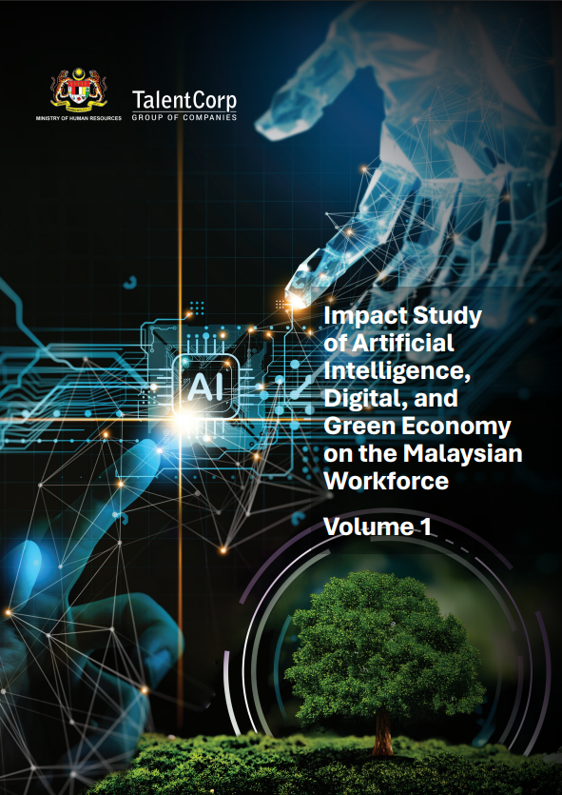
QR TO MYMAHIR
Prompt the report into an AI tool and identify the answers to the following case study
Ahmad, Form 4 student, weak in academic subjects, often absent, says school is not for him. Identify practical strengths: hands-on skills, repairing motorcycles, technical tasks.
Share your answer.
QR Code to MyMahir
Impact Study of Artificial Intelligence, Digital, and Green Economy on the Malaysian Workforce
Volume 1

Slide 34
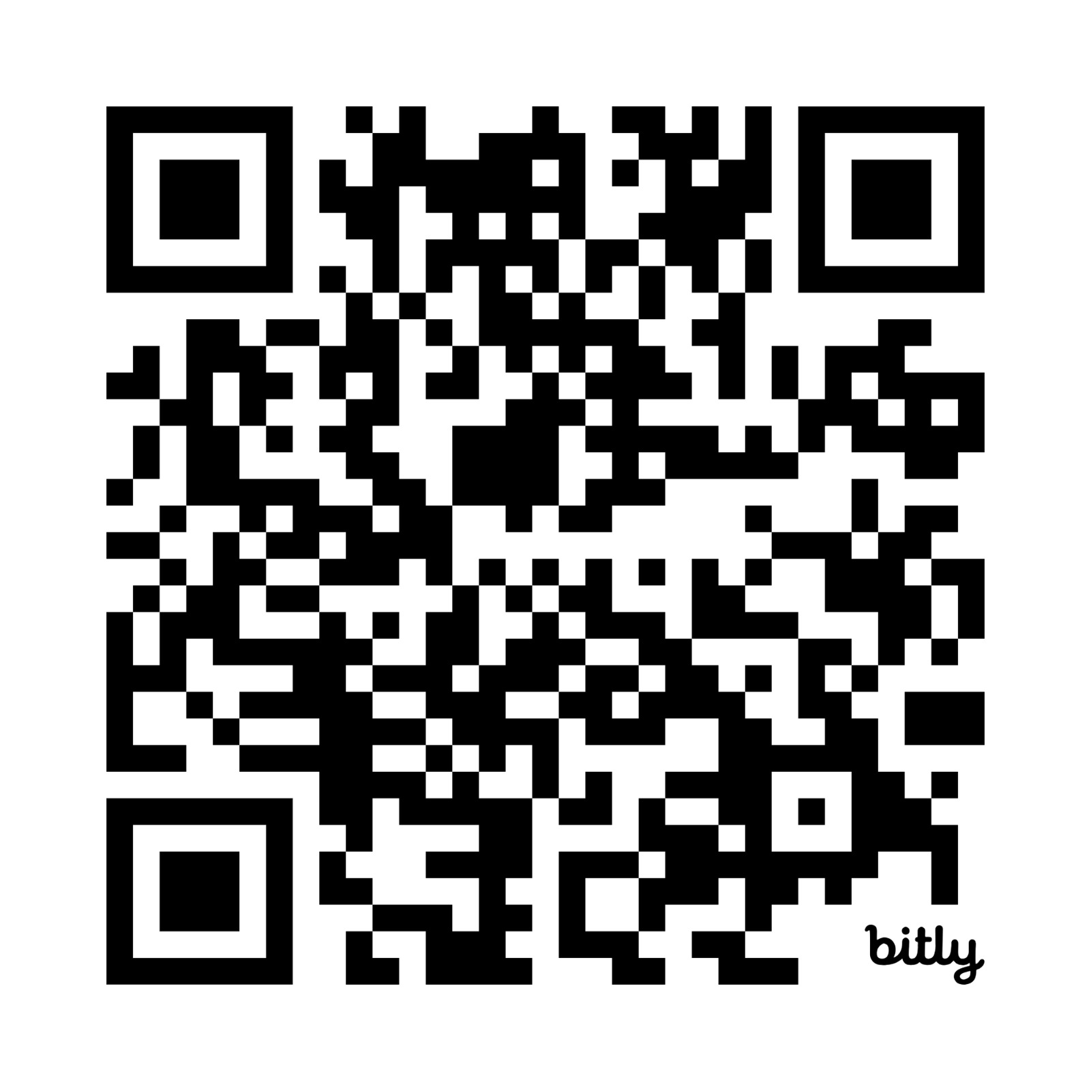
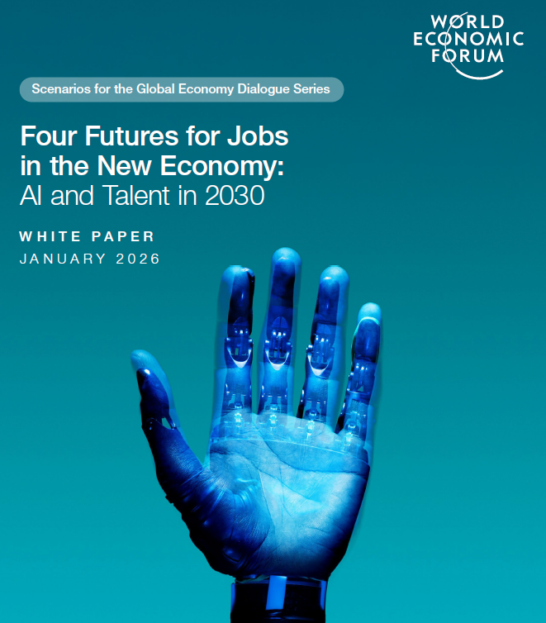
QR TO WEF
Prompt the report into an AI tool and identify the answers to the following:
List of high demand jobs.
Skills needed in the future
Key takeaways from the report.
Share your answer.
QR Code to WEF Report
Four Futures for Jobs in the New Economy: AI and Talent in 2030

Slide 35
STRATEGIC . VISIONARY . LEADING
PREPARING THE WORKFORCE FOR THE FUTURE

