Slide 1

RESUME WRITING & INTERVIEW PREPARATION
by TalentCorp

Slide 2
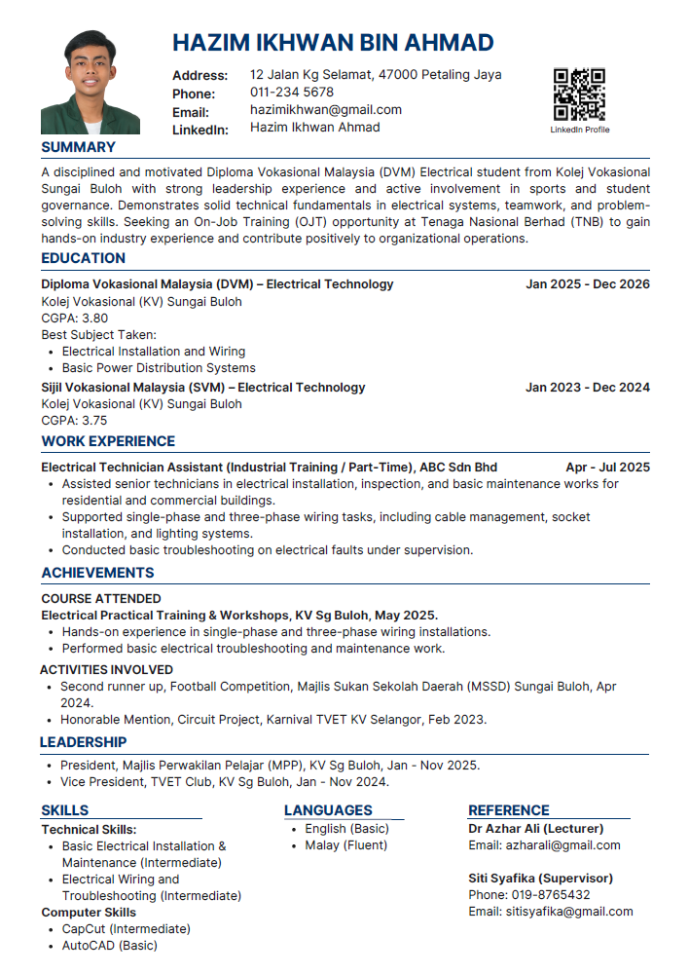
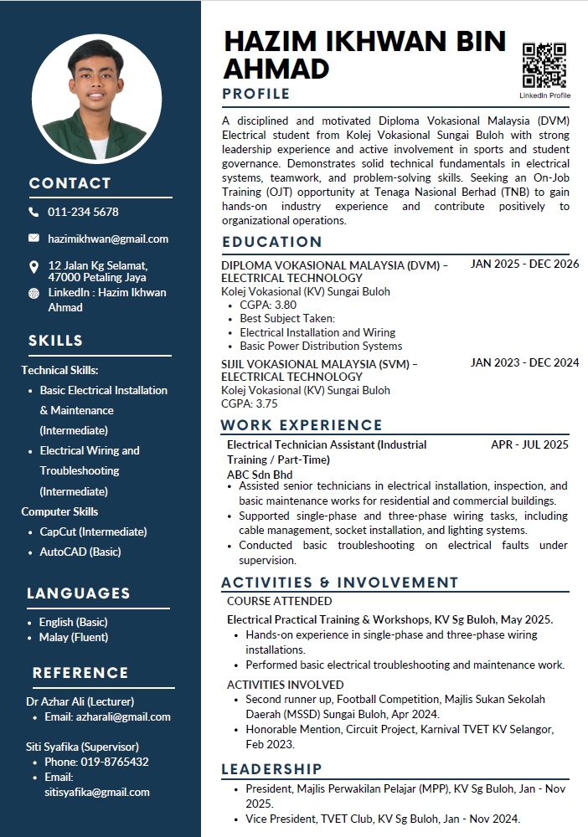
Conventional Resume
Creative Resume

Slide 3
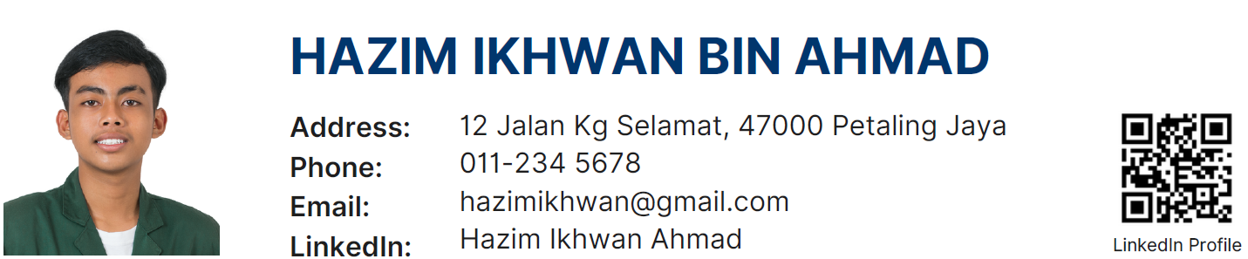
Contact Details
Important contact information of candidates.
Name
Address
Email
Phone number
Social media link
QR code to social media platform or portfolio
Professional picture
From head to shoulder

Slide 4
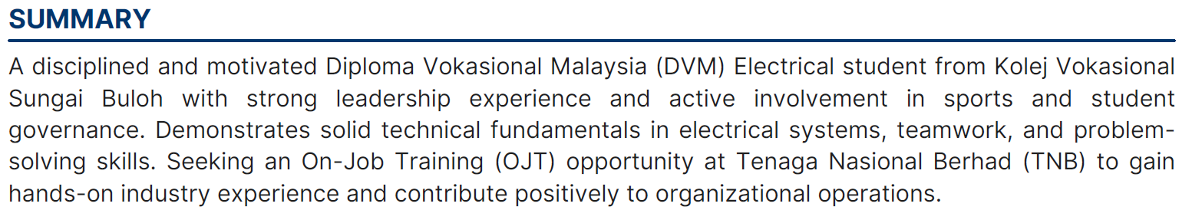
Profile
Summarize of candidate's values.
Professional Background
Skills
Experience & achievements
Career Goals

Slide 5
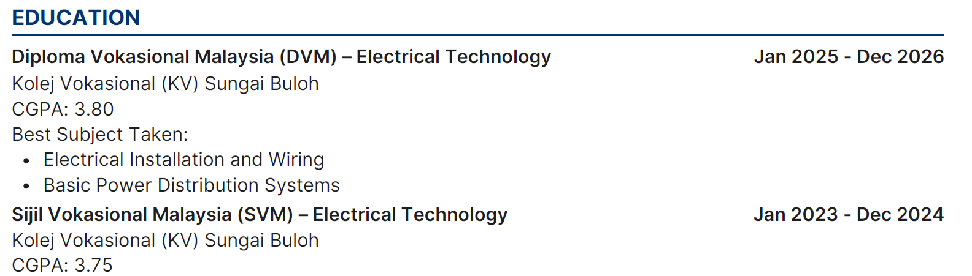
Education/ Qualification
Education background of candidates.
Academic qualifications
School/College Name
Stream/ Courses
Year of Completion
CGPA/Grades
Additional content:
Professional Certificate
Technical Certificate

Slide 6
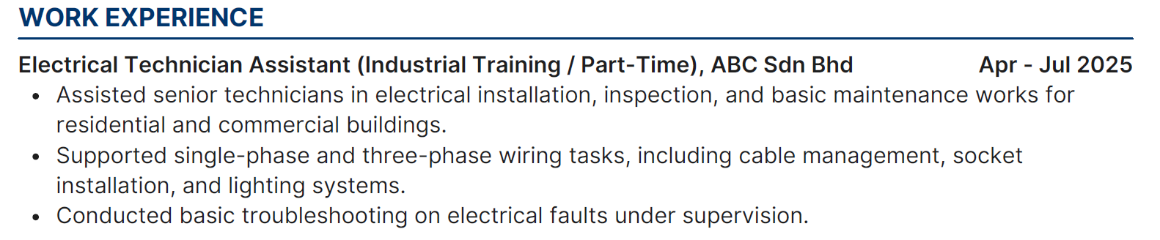
Experiences
Any related experiences relevant to position offered.
Internship
Part-time
Contract
Eg: [Position], [Company], [Duration].
Job scope related to position
Any project involved

Slide 7
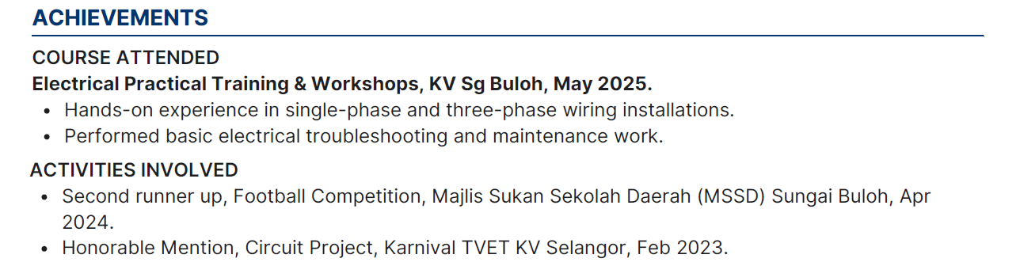
Achievement & Acknowledgement
Candidates' previous achievement and involvement.
Training and courses
Awards
Acknowledgement
Competition involved
Projects involved
Eg:[Course/Seminar/Conference], [Organizer], [Month Year].
Eg: [Prize/Award], [Event], [Organizer], [Month Year].

Slide 8
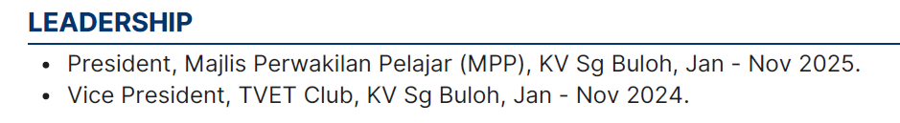
Activities & Involvements
Any position in social club, volunteerism or any society.
Any involvement
Position held
Society/Club
Volunteerism / CSR initiatives
Eg: [Position], [Society/Club], [Year].

Slide 9
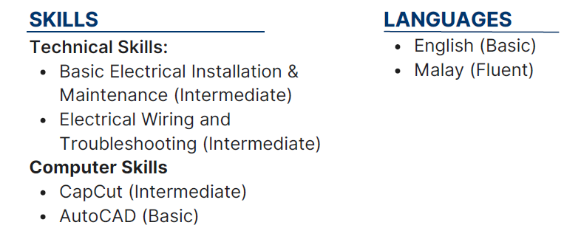
Skills & Interest
List of related skills and field of interest.
Languages
Tools
Software/Systems
Any Interest
Eg: [Skill], [(Competencies level)].
  Basic/Beginner
  Intermediate/Average
  Advance/Expert

Slide 10
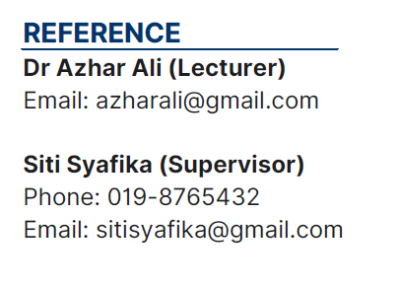
References
A superior who can provide positive feedback about you
Lecturer
Supervisor
HR executive
Any professional relationship
  Name
  Email
  Contact Number

Slide 11
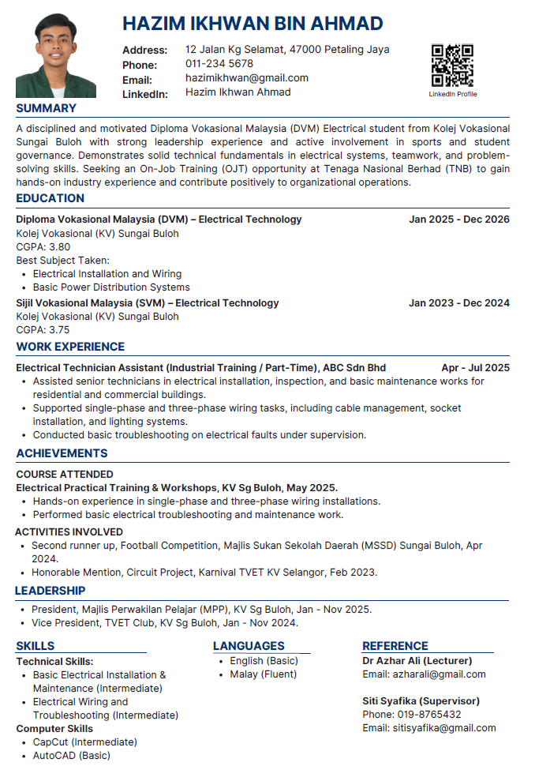

OVERALL LAYOUT
Resume Structure
Tidy and professional
Maximum 2 color combination
Use suitable fonts
Consistent Format
Point Form
KEYWORDS
Relevant keywords
Related to applications
Choose latest content
Use Header and Sub-header
KEY FOCUS
Achievements
Leadership and teamwork
Skills and interest

Slide 12
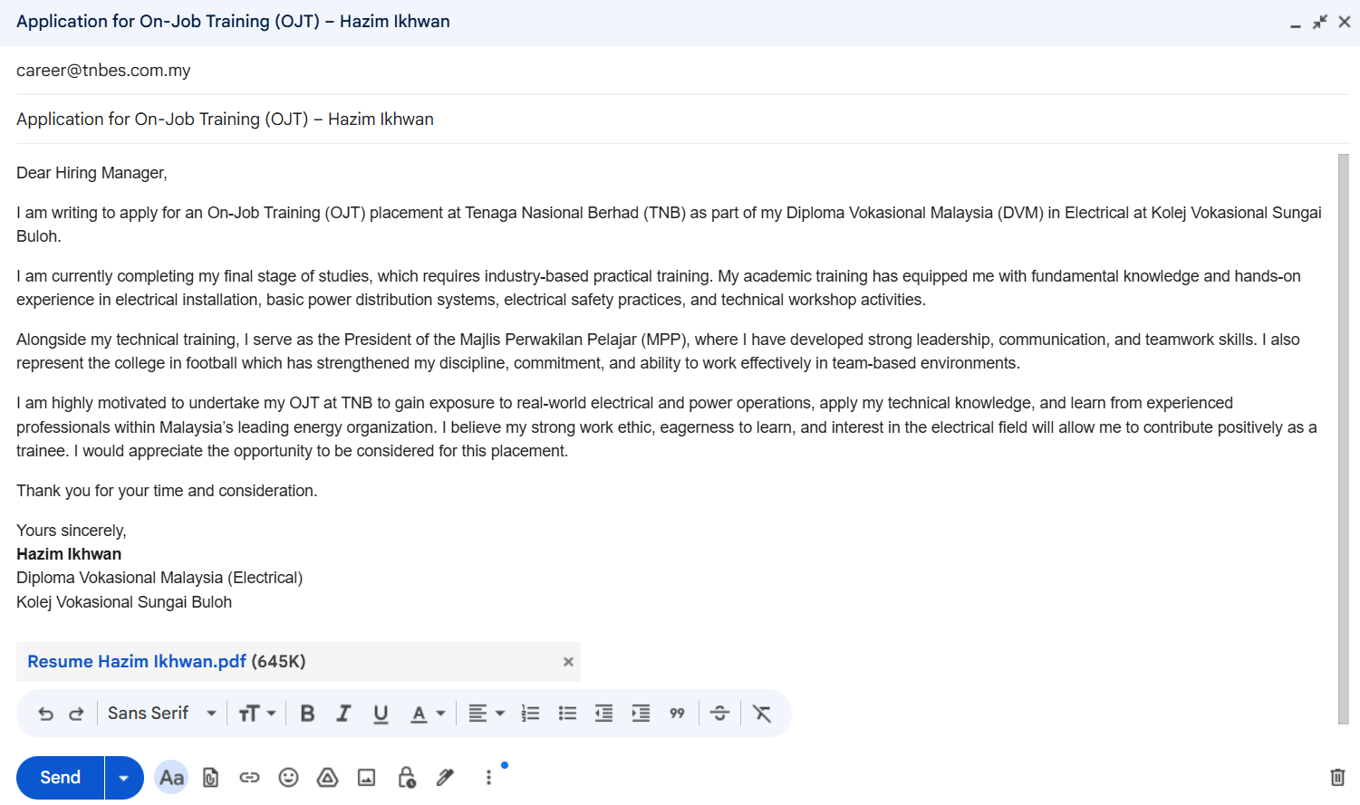
Submission the application
Company’s email
Email body
(cover letter)
Email subject
Resume in pdf. format

Slide 13
1
Can be a letter or email body.
Cover Letter content
  2
  4-5 paragraph to explaining interest in specific job.
  3
  Provide example the reasons why they should hire you.
  4
  Share experience from previous company.
  5
  Provide contact number and details.

Slide 14
Activities
List of Designation (Form 1-5)
  List out all relevant designation or cocurricular involvement
Involvement & Application matchup (Form 4-5)
  Matching purpose of resume with any involvement
Resume Mock-Up (Form 3-5)
  Write resume mock-up either in group or individual
Resume in Canva (Form 3-5)
  Using Canva application to craft the resume
Resume Submission (Form 4-5)
  Submit resume to counsellor

Slide 15
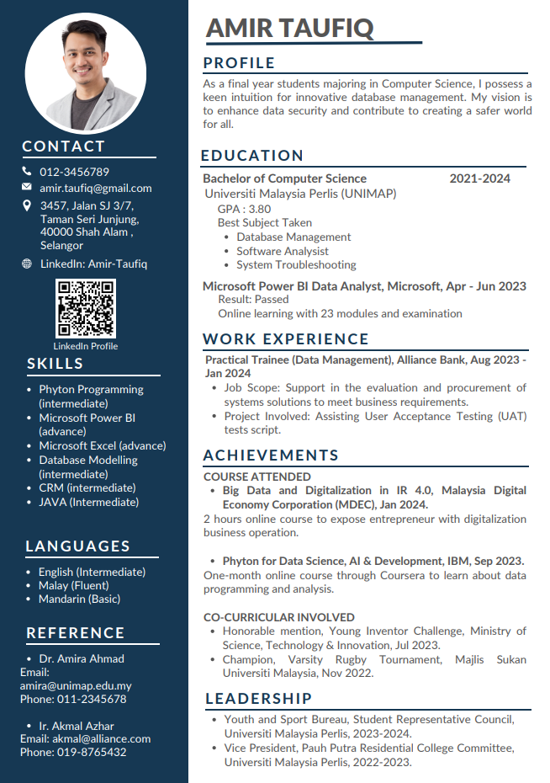
Activities 3
Resume Mock-Up (Form 3-5)

Slide 16
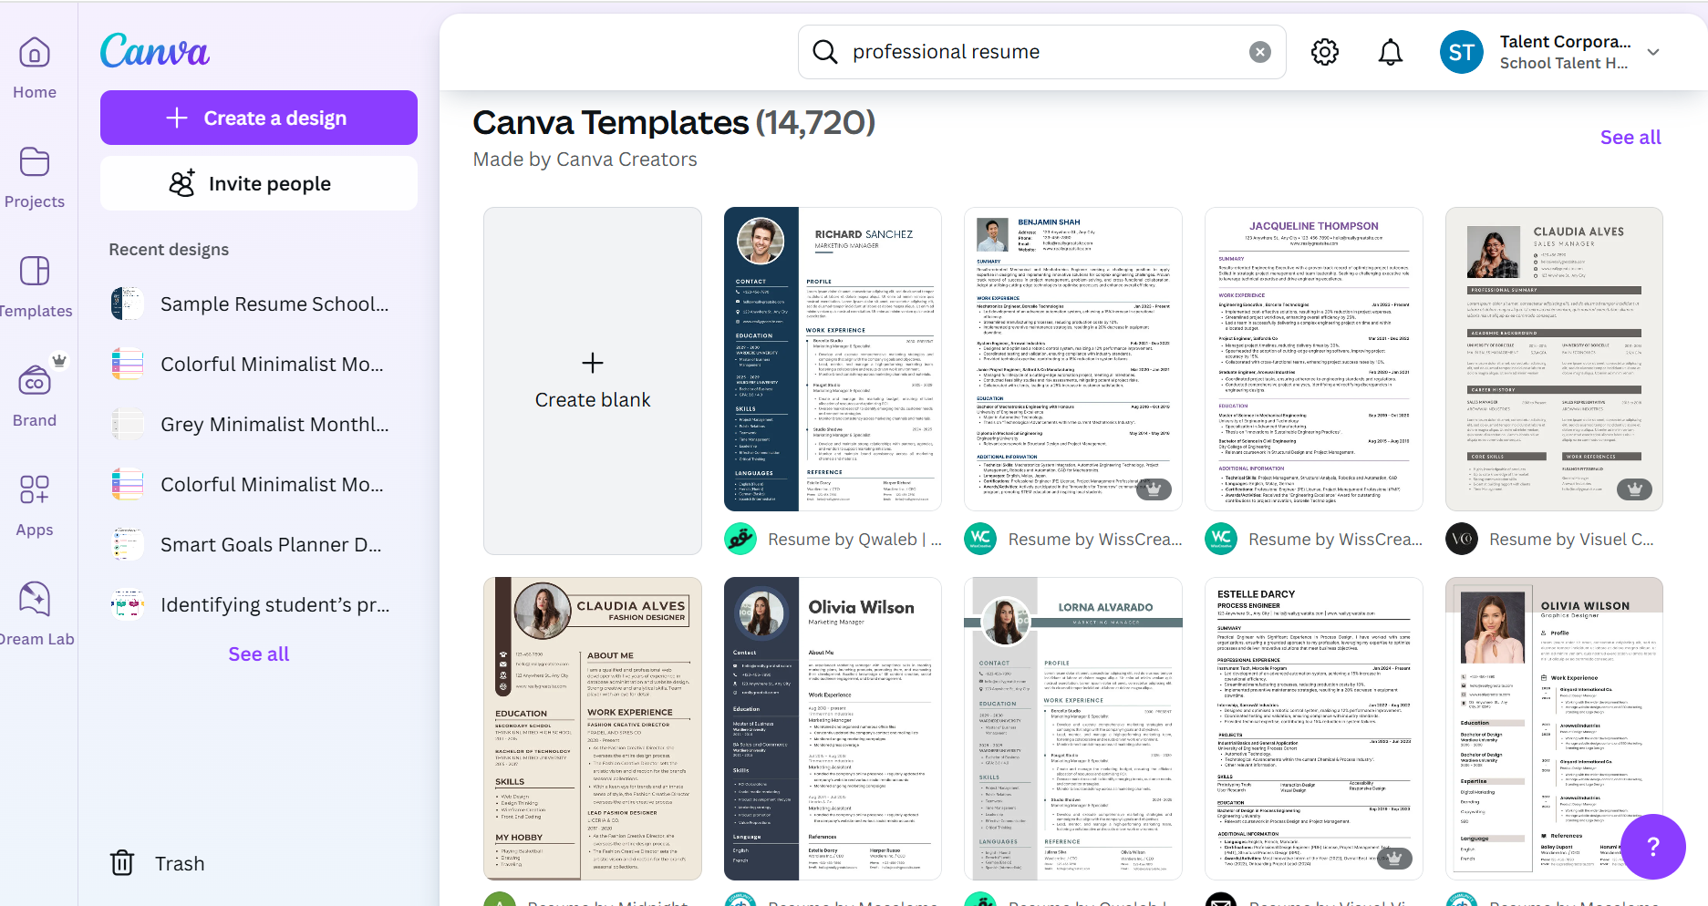
Activity 4 Resume in Canva (Form 3-5)
Using Canva to develop your resume

Slide 17
INTERVIEW PREPARATIONS

Slide 18
INTERVIEW PREPARATION
PRE INTERVIEW
DURING INTERVIEW
POST INTERVIEW
Interview Etiquettes
Physicals, Mental & Emotion
Interview Questions
After Attending Interview
Social Media Content
Self Understanding
Company Research
Professional Image & Dressing
Mock Interview
Preparations Before Interview

Slide 19
PRE INTERVIEW
Self Understanding
Company Research
Professional Image & Dressing
Mock Interview
Preparations Before Interview

Slide 20








SELF UNDERSTANDING
Background
Strength
Room for Improvement
Achievements
Career Goals
Be ready with your relevant background information.
Focus more on yourself rather than share family background.
Understand your strength, which environment help you the most, what kind of work you preferred.
What kind of personality that you have.
Always have career goals. What you want to achieve? What kind of career you looking for.
Be ambitious, dream big.
Always understand what you should improve yourself.
Everybody have flaws but be ready with any possible solution or how to overcome it.
What is your biggest achievement?
Does that achievement help you to success in future?
It can be awards, acknowledgement or even self reflect to yourself.

Slide 21
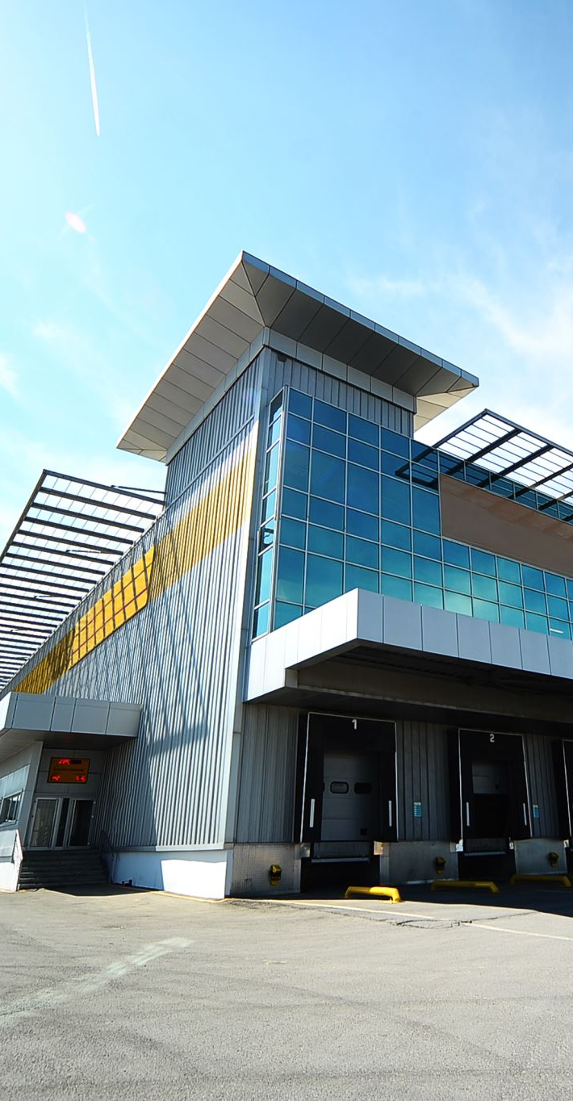



COMPANY RESEARCH
Do some research on company/organizations and the position.
Use official website or news portal. Don’t search for rumors or negative information about company.
Understand job scope and what will you do if you get the position.
Get to know company’s products or services. Be ready with the examples.

Slide 22

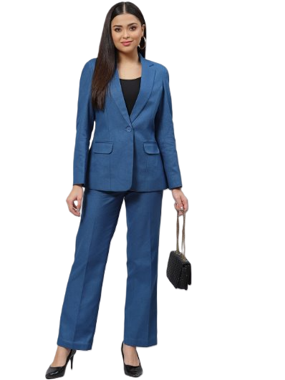
PROFESSIONAL IMAGE & DRESSING
First impression matters.
Wear clean, neat and appropriate attire.
Prepare attire checklist. Know what you should & shouldn’t wear.
Wear suitable attire.
Apply T.O.P.P ( Time, Occasion, Place, Purpose).

Slide 23
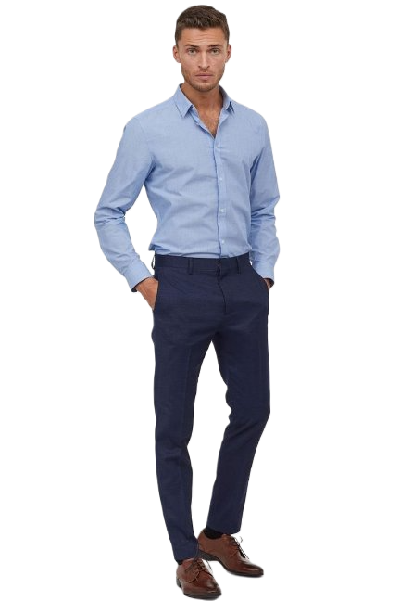


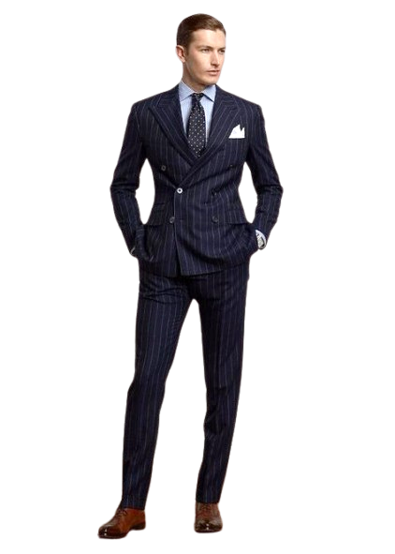
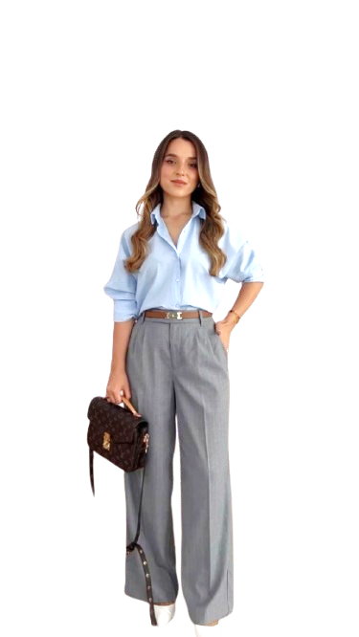

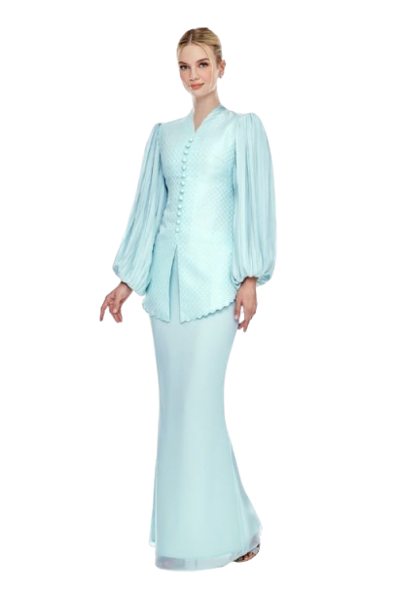

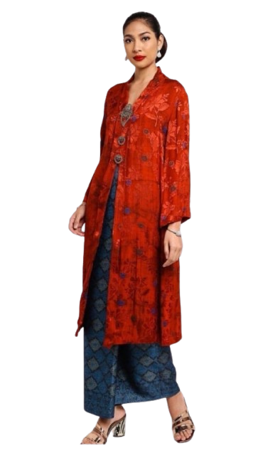


CASUAL
SEMI-FORMAL
FORMAL

Slide 24
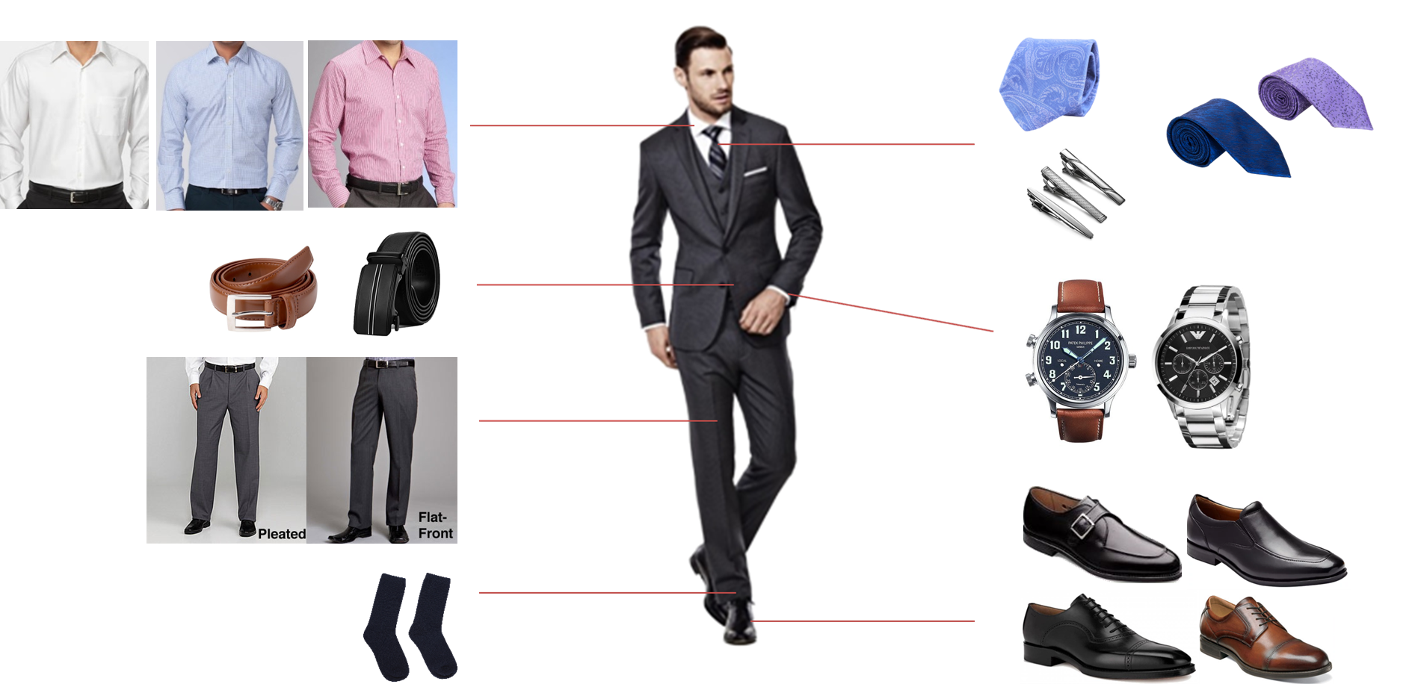

Slide 25
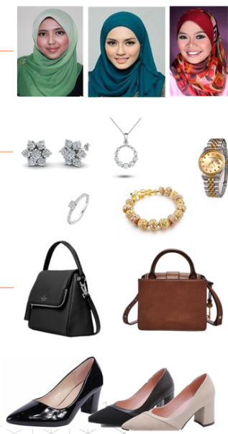

Slide 26
PREPARATIONS BEFORE INTERVIEW
Interview Location – plan your journey, be specific eg: building, floor, room.
Arrive early, at least 30 minutes before interview session.
For online interview, please make sure internet connection is in good condition, have professional background.
Always have contingency plans.

Slide 27
Practice Makes Perfect
MOCK INTERVIEW
Communication Skills
Simulate real interview scenarios
Practice common questions.
Refine your delivery
Get Feedback
Be clear and concise
Use positive body language
Practice storytelling
Find Your Mentor
Request constructive criticism.
Analyse weak points.
Improve continuously
Seek guidance from industry professionals.
Learn from their experience.
Mock interviews with experts

Slide 28
DURING INTERVIEW
Interview Etiquettes
Physicals, Mental & Emotion
Interview Questions

Slide 29






INTERVIEW ETIQUETTES
Smile
Eye Contact
Body Language
Greetings
Handshake

Slide 30



PHYSICALS, MENTAL & EMOTION
Take care of your physical health
Take care of your mental health
Control your emotion

Slide 31
INTERVIEW QUESTIONS
Self-introduction - Interviewer want to know more about you.
Tell stories about you.
Your strength, ability, values.
Your interest, passion.

Slide 32
INTERVIEW QUESTIONS
Wrap the interview session as professional as you can be.
Ask any related question.
Thank you
"Before we end the session, is there any question?"

Slide 33
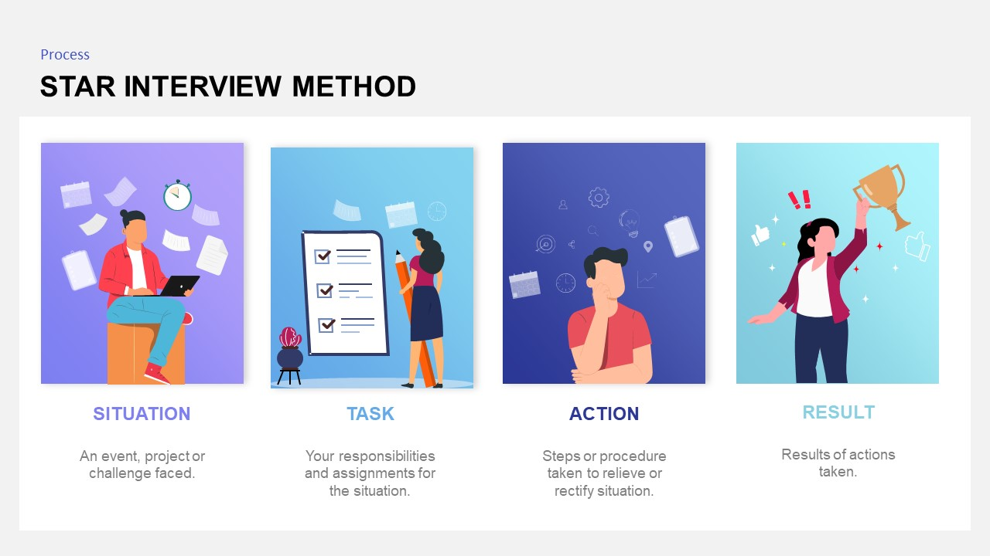

Slide 34
INTERVIEW COMMUNICATION
VERBAL
NON-VERBAL
Importance of body language
Eye contact, hand gestures, and posture
Facial expressions and their role in building rapport
Active listening and showing engagement
Clarity and confidence in speaking
Tone of voice: how it affects perception
Avoiding filler words (e.g., "um", "like")
Structuring your responses (problem-solution approach)
Asking insightful questions

Slide 35
POST INTERVIEW
After Attending Interview
Social Media Content

Slide 36
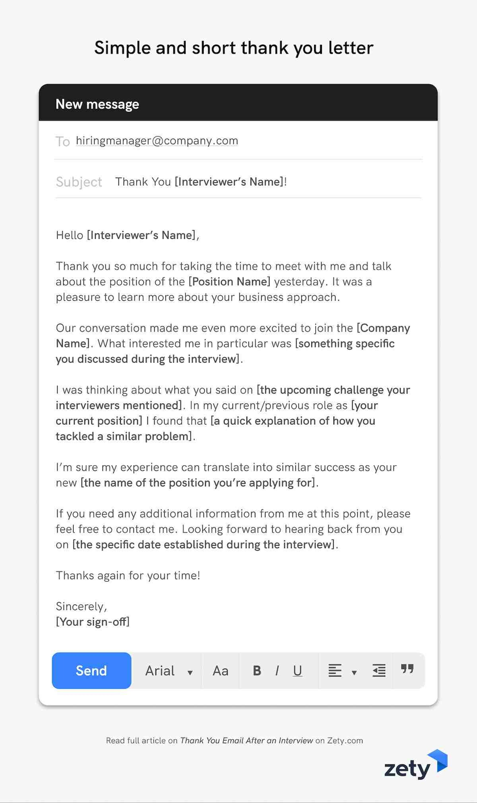
THANK YOU NOTE
Show your gratitude to your interviewer.
Send an email.
"Thank you for inviting me to the interview session."

Slide 37

FOLLOW-UP CALL
Do follow-up with your interviewer after 2 weeks.
Make a phone call or email, to get the interview results or their feedback.
Only once, do not make them feel uncomfortable. .
"Hi, I'm candidate from interview session ....."

Slide 38

SOCIAL MEDIA CONTENT
Do not share company’s details on your social media or what happen during interview session, some company may not favor your digital content.
Your digital present are important, use it wisely.

Slide 39
Activities
Formal Attire Match Up (Form 1-5)
  Matching the picture of formal attire
Speak-up Practice (Form 1-5)
  Practice speaking with partners based on topics given.
1 minute Pitching (Form 1-5)
  Speak in public form 1 minute in any topics.
Mock Interview (Form 4-5)
  Interview session with teachers or parents

