Slide 1
Object-Oriented Software Engineering
Practical Software Development using UML and Java
Chapter 11:
Managing the Software Development Process

Slide 2
11.1 What is Project Management?
Project management encompasses all the activities needed to plan and execute a project:
  Deciding what needs to be done
  Estimating costs
  Ensuring that there are suitable people to undertake the project
  Defining responsibilities
  Scheduling
  Making arrangements for the work
  continued ...

Slide 3
What is Project Management?
  Directing
  Being a technical leader
  Reviewing and approving decisions made by others
  Building morale and supporting staff
  Monitoring and controlling
  Coordinating the work with managers of other projects
  Reporting
  Continually striving to improve the process

Slide 4
11.2 Software Process Models
Software process models are general approaches for organizing a project into activities.
  Help the project manager and his or her team to decide:
    What work should be done
    In what sequence to perform the work.
  The models should be seen as aids to thinking, not rigid prescriptions of the way to do things.
  Each project ends up with its own unique plan.

Slide 5
The opportunistic approach

Slide 6
The opportunistic approach
… is what occurs when an organization does not follow good engineering practices.
  It does not acknowledge the importance of working out the requirements and the design before implementing a system.
  The design of software deteriorates faster if it is not well designed.
  Since there are no plans, there is nothing to aim towards.
  There is no explicit recognition of the need for systematic testing and other forms of quality assurance.
  The above problems make the cost of developing and maintaining software very high.

Slide 7
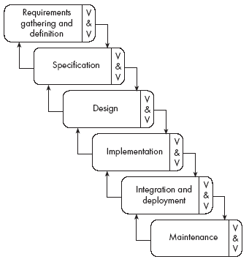
The waterfall model

Slide 8
The waterfall model
The classic way of looking at software engineering that accounts for the importance of requirements, design and quality assurance.
  The model suggests that software engineers should work in a series of stages.
  Before completing each stage, they should perform quality assurance (verification and validation).
  The waterfall model discourages going back to earlier stages.

Slide 9
Limitations of the waterfall model
  The model implies that you should attempt to complete a given stage before moving on to the next stage
    Does not account for the fact that requirements constantly change.
    It also means that customers cannot use anything until the entire system is complete.
  The model makes no allowances for prototyping.
  It implies that you can get the requirements right by simply collecting them early in the project history.

Slide 10
Agile Software Development Method
The twenty-first century customer demands a quality application delivered almost immediately
In 2001 a group of developers met to discuss the state of lightweight (not too many rigorous rules) and rapid development methodologies
They created the "Manifesto for Agile Software Development," a document that became the cornerstone of the Agile movement

Slide 11
Agile Software Development Method
We are uncovering better ways of developing software by doing it and helping others do it
Through this work we have come to value:
Individuals and interactions over processes and tools
Working software over comprehensive documentation
Customer collaboration over contract negotiation
Responding to change over following a plan
That is, while there is value in the items on the right, we value the items on the left more

Slide 12
The Agile Model
Agile = “Characterized by quickness, lightness, and ease of movement”
Agile Software development is about fast delivery of software with more ease of development
Emphasizes customer satisfaction through continuous delivery of functional software
The two most popular methods are Scrum and eXtreme Programming (XP)

Slide 13
Key Features of Agile Development
Iterative: Entire application is distributed in incremental units called iterations. Development time of each iteration is small (couple of weeks), fixed and strictly adhered to. Every Iteration is a mini-increment of the functionality and is build on top of previous iteration.
Active Customer Involvement: There is a lot of client involvement and face-to-face interaction. Every iteration is tested and approved by the client. The feedback obtained is implemented in subsequent iterations; thus minimizing risk and ensuring higher client satisfaction.

Slide 14
Key Features of Agile Development
Feature Driven: More emphasis is on providing the required features in the application. 80/20 principle is applied to decide the 20% of features which will be used 80% of the time.
Fixed Time: Each iteration has a fixed time span (couple of weeks) in which it is delivered.
Priority-Based Delivery: Features are prioritized depending on customer need, development risk, etc. High priority features are developed first. After every iteration, the project priorities are re-evaluated.

Slide 15
Key Features of Agile Development
Adaptive: The methodology in general is very adaptive, so that the application that is developed can cater to the arrival of new requirements throughout its development. Goal is not to remove the uncertainty in the very beginning, but is to adapt to the changing needs.
Empowered Teams: Project teams are generally small and have lot of interaction and communication. Since the entire team is actively involved, the team is empowered to make decisions.

Slide 16
Key Features of Agile Development
People Centric: More emphasis is on using well-skilled people to do the development than on following specific processes. Documentation and other non-development activities are minimized and more time is devoted to development and testing.
More Disciplined: Everything should be delivered correctly the first time. So the process involves a lot of team discipline and self-discipline. Thus, it requires highly-skilled and organized team members.
Simplicity: Emphasis is on keeping things as simple as possible and being open to change.

Slide 17
Why should Agile be considered?
Benefits to the Customer
Customer is more actively involved, and gets higher priority
Customer gets regular and frequent status updates
Requirements are "accepted" after each iteration
Agile methodology emphasizes rapid delivery. So the key functionalities can be available to use sooner.
Delivery is defined by a fixed timescale. So the customer is assured of receiving some functionality by a fixed time period.
More testing is done, so better software quality is delivered

Slide 18
Why should Agile be considered?
Benefits to the Project Team
Project team is involved more actively in all the stages. The team members collaboratively make decisions and are more empowered.
Since the development is incremental, team can focus on the current requirements at any given point of time.
More emphasis is on developing the application only, and not on documentation. Simple and minimal documents are used.
Less time is spent in gathering requirements as all the requirements are not gathered up front and are implemented only when they arise.

Slide 19
Why should Agile be considered?
Benefits to the Project Team (continued)
Less time is required for planning.
Less cost of development as rework, management, documentation, and other non-development work-related cost is reduced.
Team develops application collaboratively and in a cooperative environment.

Slide 20
Agile is difficult since...
It requires more testing and active customer involvement.
It impacts management more than developers. Management has to be more open, be actively involved in the development process and (most importantly) allow the team to make decisions.
Code will be integrated continuously. To ensure the application is always in a workable state, all the code has to work … always.
Highly skilled and flexible people with passion should be involved.

Slide 21
Agile is best suited for a project with...
Frequently changing requirements
The team and the customer are co-located
Client open to lot of involvement and ready to invest time

Slide 22
The Process of Agile Software Development
Kick-off meeting.
Known requirements are understood and prioritized. Development plan is proposed accordingly.
Relative complexity of each requirement is estimated.
Sufficient design using simple diagrams is done.
Test Driven Development (TDD) approach may be used. TDD emphases “writing test first and then writing code to pass the test”. It can help in avoiding over-coding.
Development is done sometimes in pairs with a lot of team interaction. Ownership of code is shared when pair programming is done.
Code is tested more frequently.

Slide 23
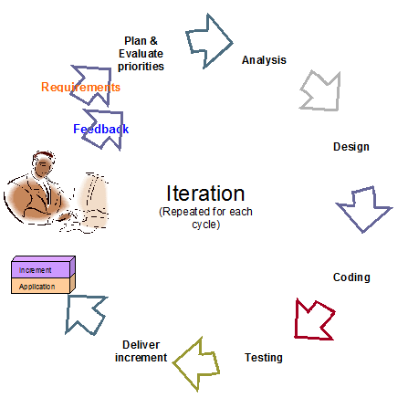
Iteration Life Cycle Stages

Slide 24
Reengineering
Periodically project managers should set aside some time to re-engineer part or all of the system
  The extent of this work can vary considerably:
    Cleaning up the code to make it more readable.
    Completely replacing a layer.
    Re-factoring part of the design.
  In general, the objective of a re-engineering activity is to increase maintainability.

Slide 25
11.3 Cost estimation
To estimate how much software engineering time will be required to do some work.
  Elapsed time
    The difference in time from the start date to the end date of a task or project.
  Development effort
    The amount of labor used in person-months or person-days.
    To convert an estimate of development effort to an amount of money:
      You multiply it by the weighted average cost (burdened cost) of employing a software engineer for a month (or a day).

Slide 26
Principles of effective cost estimation
Principle 1: Divide and conquer.
  To make a better estimate, you should divide the project up into individual subsystems.
  Then divide each subsystem further into the activities that will be required to develop it.
  Then make a series of detailed estimates for each individual activity.
  Then sum the results to arrive at the grand total estimate for the project.

Slide 27
Principles of effective cost estimation
Principle 2: Include all activities when making estimates.
  The time required for all development activities must be taken into account.
  Including:
      Prototyping
      Design
      Inspecting
      Testing
      Debugging
      Writing user documentation
      Deployment.

Slide 28
Principles of effective cost estimation
Principle 3: Base your estimates on past experience combined with knowledge of the current project.
  If you are developing a project that has many similarities with a past project:
    You can expect it to take a similar amount of work.
  Base your estimates on the personal judgement of your experts
    or
  Use algorithmic models developed in the software industry as a whole by analyzing a wide range of projects.
    They take into account various aspects of a project’s size and complexity, and provide formulas to compute anticipated cost.

Slide 29
Algorithmic models
Allow you to systematically estimate development effort.
  Based on an estimate of some other factor that you can measure, or that is easier to estimate:
    The number of use cases
    The number of distinct requirements
    The number of classes in the domain model
    The number of widgets in the prototype user interface
    An estimate of the number of lines of code

Slide 30
Principles of effective cost estimation
Principle 4: Be sure to account for differences when extrapolating from other projects.
  Different software developers
  Different development processes and maturity levels
  Different types of customers and users
  Different schedule demands
  Different technology
  Different technical complexity of the requirements
  Different domains
  Different levels of requirement stability

Slide 31
Principles of effective cost estimation
Principle 5: Anticipate the worst case and plan for contingencies.
  Develop the most critical use cases first
    If the project runs into difficulty, then the critical features are more likely to have been completed
  Make three estimates:
    Optimistic (O)
      Imagining everything going perfectly
    Likely (L)
      Allowing for typical things going wrong
    Pessimistic (P)
      Accounting for everything that could go wrong

Slide 32
Principles of effective cost estimation
Principle 6: Combine multiple independent estimates.
  Use several different techniques and compare the results.
  If there are discrepancies, analyze your calculations to discover what factors causing the differences.
  Use the Delphi technique.
    Several individuals initially make cost estimates in private.
    They then share their estimates to discover the discrepancies.
    Each individual repeatedly adjusts his or her estimates until a consensus is reached.

Slide 33
Scrum Poker
Scrum Poker is a consensus-based technique for estimating effort
Variation of the Delphi method
Members of the group make estimates by playing numbered cards face-down on the table instead of speaking estimates aloud
Cards are revealed and estimates are discussed

Slide 34
Scrum Poker
Avoids the bias of "anchoring" -- first number sets a precedent for subsequent estimates
Some organizations use standard playing cards of Ace (1), 2, 3, 5, 8, and King
King means "This item is too big or too complicated to estimate"
Smartphones allow developers to use apps instead of physical card decks

Slide 35
Principles of effective cost estimation
Principle 7: Revise and refine estimates as work progresses
  As you add detail.
  As the requirements change.
  As the risk management process uncovers problems.

Slide 36
11.4 Software Engineering Teams
Software engineering is a human process.
  Choosing appropriate people for a team, and assigning roles and responsibilities to the team members, is therefore an important project management skill
  Software engineering teams can be organized in many different ways

Slide 37
Software engineering teams
Egoless team:
  Also called a “self-organizing team”
  In such a team everybody is equal, and the team works together to achieve a common goal.
  Decisions are made by consensus.
  Most suited to difficult projects with many technical challenges.
  Egoless/self-organizing is the typical Agile team organization.

Slide 38
Software engineering teams
Hierarchical manager-subordinate structure:
  Each individual reports to a manager and is responsible for performing the tasks delegated by that manager.
  Suitable for large projects with a strict schedule where everybody is well-trained and has a well-defined role.
  However, since everybody is only responsible for their own work, problems may go unnoticed.

Slide 39
Software engineering teams
Chief programmer team:
  Midway between egoless and hierarchical.
  The chief programmer leads and guides the project.
  He or she consults with, and relies on, individual specialists.

Slide 40
Choosing an effective size for a team
  For a given estimated development effort, in person months, there is an optimal team size.
    Doubling the size of a team will not halve the development time.
  Subsystems and teams should be sized such that the total amount of required knowledge and exchange of information is reduced.
  For a given project or project iteration, the number of people on a team will not be constant.
  You cannot generally add people if you get behind schedule, in the hope of catching up.

Slide 41
Skills needed on a team
  Architect
  Project manager
  Configuration management and build specialist
  User interface specialist
  Technology specialist
  Hardware and third-party software specialist
  User documentation specialist
  Tester

Slide 42
11.5 Project Scheduling and Tracking
  Scheduling is the process of deciding:
    In what sequence a set of activities will be performed.
    When they should start and be completed.
  Tracking is the process of determining how well you are sticking to the cost estimate and schedule.

Slide 43
PERT charts
A PERT chart shows the sequence in which tasks must be completed.
  In each node of a PERT chart, you typically show the elapsed time and effort estimates.
  The critical path indicates the minimum time in which it is possible to complete the project.

Slide 44
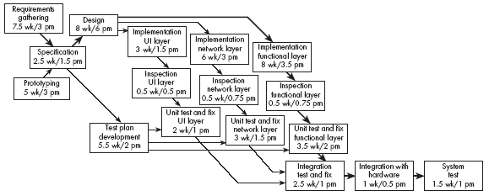
Example of a PERT chart

Slide 45
Gantt charts
A Gantt chart is used to graphically present the start and end dates of each software engineering task
  One axis shows time.
  The other axis shows the activities that will be performed.
  The black bars are the top-level tasks.
  The white bars are subtasks
  The diamonds are milestones:
    Important deadline dates, at which specific events may occur

Slide 46
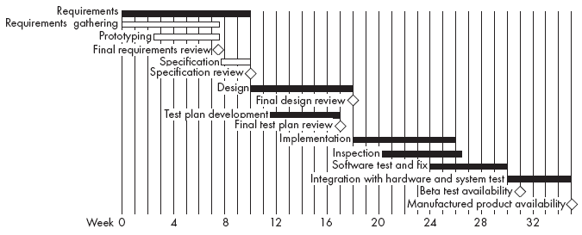
Example of a Gantt chart

Slide 47
Earned value
  Earned value is the amount of work completed, measured according to the budgeted effort that the work was supposed to consume.
  It is also called the budgeted cost of work performed.
  As each task is completed, the number of person-months originally planned for that task is added to the earned value of the project.

Slide 48
Earned value charts
An earned value chart has three curves:
  The budgeted cost of the work scheduled.
  The earned value.
  The actual cost of the work performed so far.

Slide 49
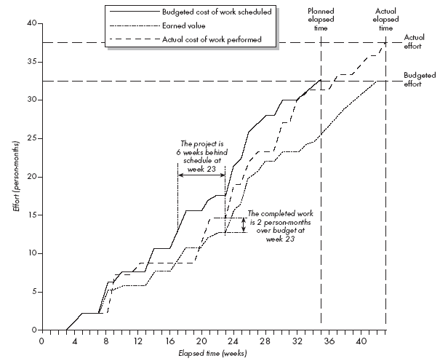
Example of an earned value chart

Slide 50
11.6 Contents of a Project Plan
Purpose -- Describe the problem to be solved (like Requirements Document). Objectives of project.
B. Background information -- Brief history of project. Describe stakeholders. References to documents produced so far.
C. Processes to be used -- Not necessary for CS 307.

Slide 51
11.6 Contents of a Project Plan
D. Subsystems and planned releases -- Division of system into Iterations1-3. What characterizes each Iteration?
E. Risks and challenges -- Risks and difficulties expected to be most critical to this project. Indicate how these will be monitored and resolved.
F. Tasks -- List of tasks to be completed for each Iteration.

Slide 52
11.6 Contents of a Project Plan
G. Cost estimates -- Cost estimates for each Iteration in hours. Include pessimistic and optimistic estimates.
H. Team -- Describe team structure for implementation. Responsibilities of each team member.
I. Schedule and milestones -- Not necessary for CS 307.

Slide 53
11.7 Difficulties and Risks in Project Management
  Accurately estimating costs is a constant challenge
    Follow the cost estimation guidelines.
  It is very difficult to measure progress and meet deadlines
    Improve your cost estimation skills so as to account for the kinds of problems that may occur.
    Develop a closer relationship with other members of the team.
    Be realistic in initial requirements gathering, and follow an iterative approach.
    Use earned value charts to monitor progress.

Slide 54
Difficulties and Risks in Project Management
  It is difficult to deal with lack of human resources or technology needed to successfully run a project
    When determining the requirements and the project plan, take into consideration the resources available.
    If you cannot find skilled people or suitable technology then you must limit the scope of your project.

Slide 55
Difficulties and Risks in Project Management
  Communicating effectively in a large project is hard
    Take courses in communication, both written and oral.
    Learn how to run effective meetings.
    Review what information everybody should have, and make sure they have it.
    Make sure that project information is readily available.
    Use ‘groupware’ technology to help people exchange the information they need to know

Slide 56
Difficulties and Risks in Project Management
  It is hard to obtain agreement and commitment from others
    Take courses in negotiating skills and leadership.
    Ensure that everybody understands
      The position of everybody else.
      The costs and benefits of each alternative.
      The rationale behind any compromises.
    Ensure that everybody’s proposed responsibility is clearly expressed.
    Listen to everybody’s opinion, but take assertive action, when needed, to ensure progress occurs.

